Slide 1
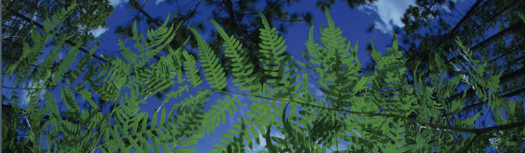

Climate Processing Using QGIS
University of Florida

Slide 2


Acknowledgments
Dr. Rhett Rautsaw
Dr. João Vidal Jr.

Slide 3
Outline of processing layers with QGIS
1 – Load bioclim raster
2 – Load occurrence data
3 – Create alpha hull
4 – Calculate distance matrix
5 – Calculate basic statistics for buffer
6 – Reproject layer
7 – Create buffer
8 – Create clipped mask

Slide 4
Outline of processing layers with QGIS
9 – Vectorize clipped bioclim layer (creating mask)
10 – Fix geometries of the vector (creating mask)
11 – Dissolve the vector (creating mask)
12 – Create random points
13 – Sample all clipped rasters (save as .csv)
14 – Calculate correlation
15 – Eliminate correlated layers randomly

Slide 5
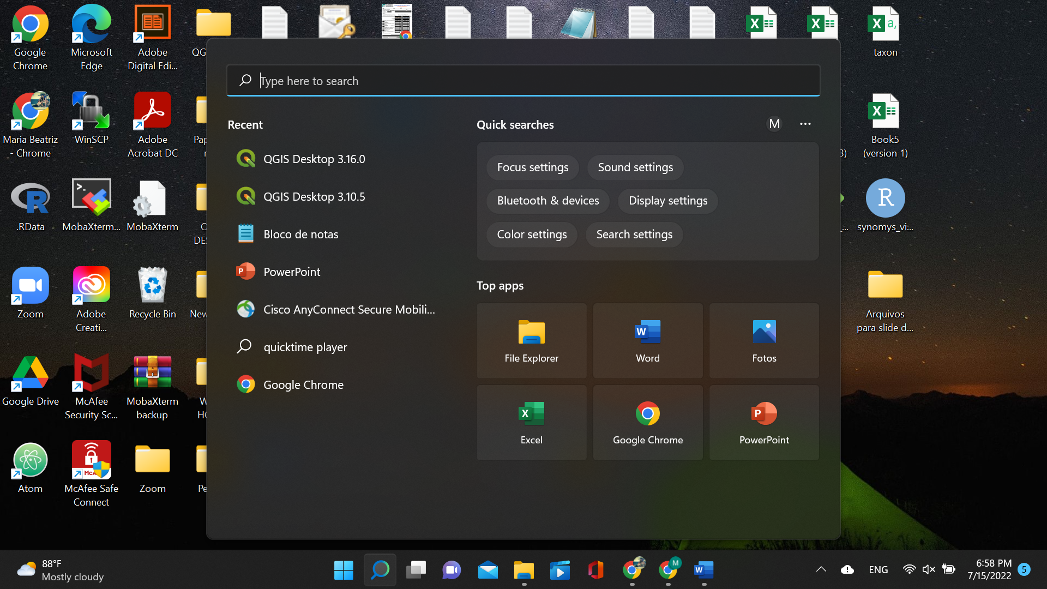
Opening QGIS
Both versions
3.16 (Hannover) and
3.10 (A Coruña)
work for this tutorial

Slide 6
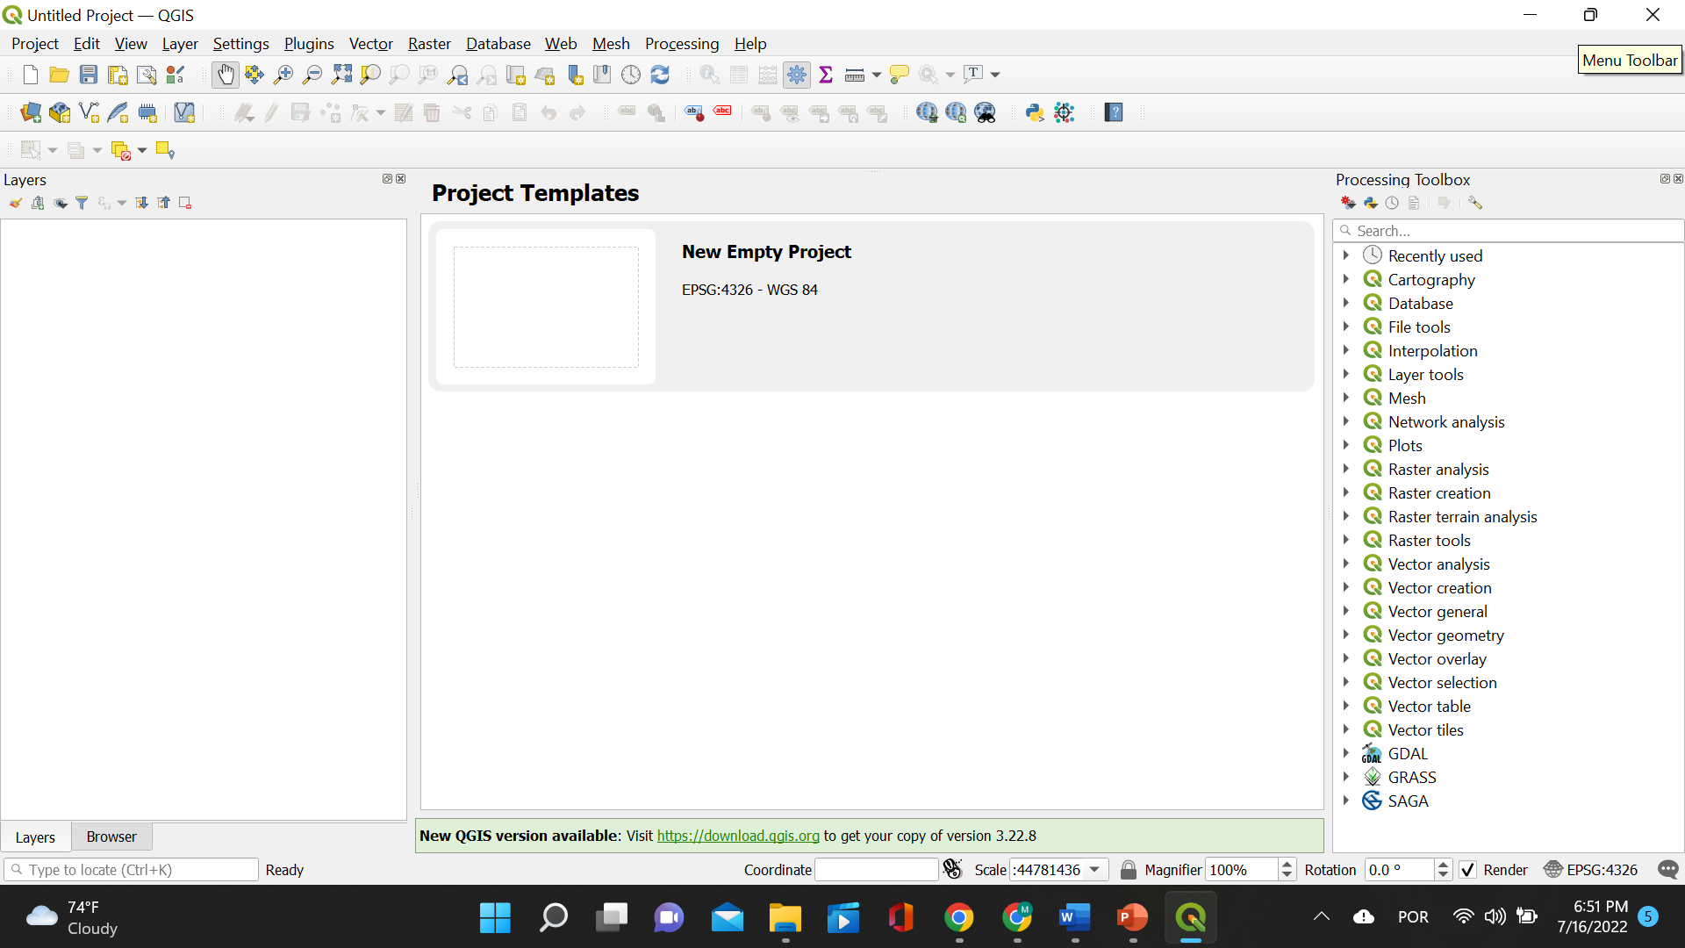
Opening QGIS

Slide 7
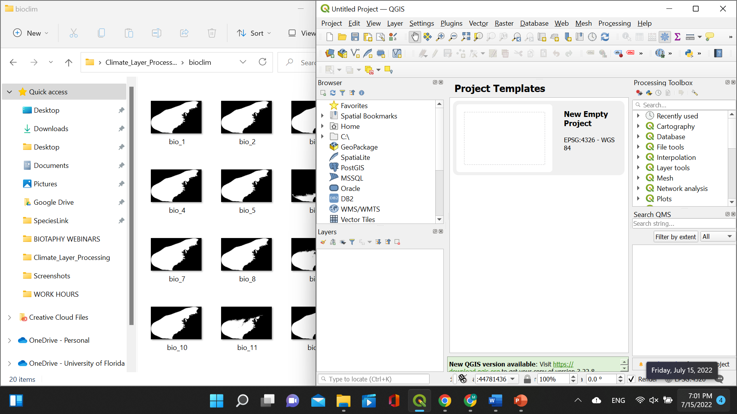
1 – Load bioclim raster
Drag one bioclim layer to the opened and empty QGIS window.

Slide 8
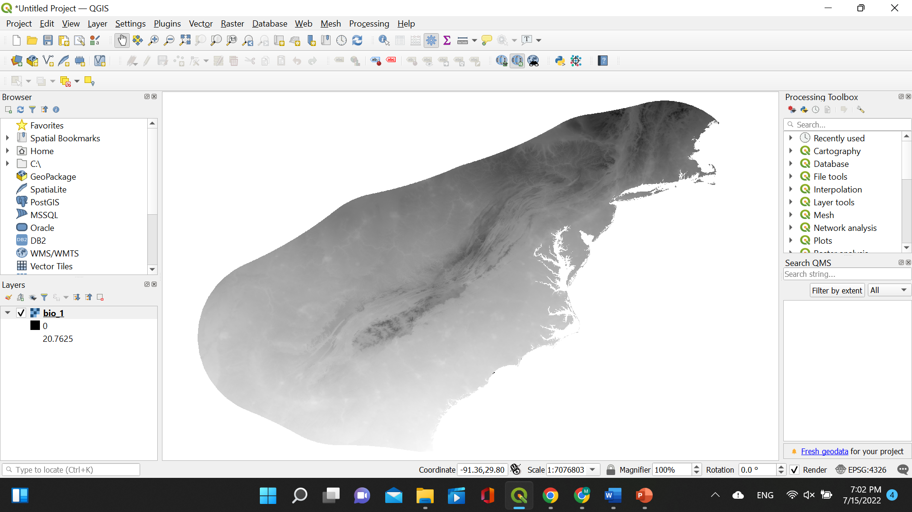
1 – Load bioclim raster
Layer should load and in the left side of QGIS you should see a panel named “Layers”.

Slide 9
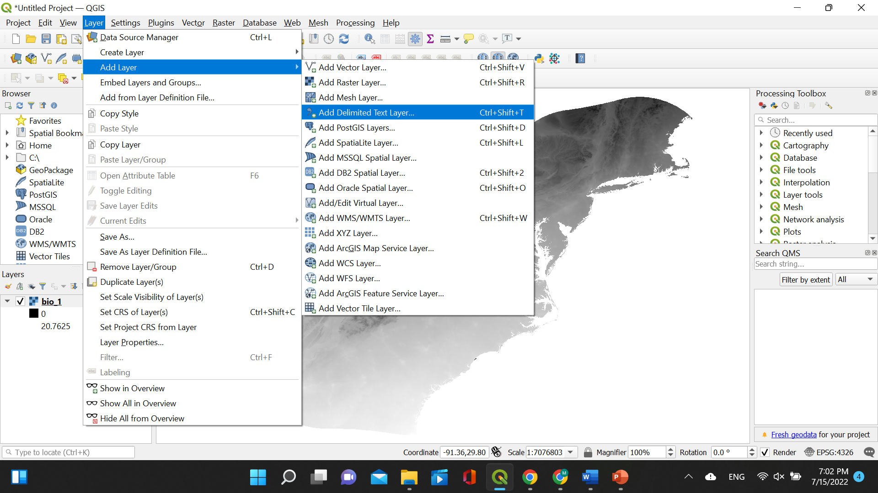
2 – Load occurrence data
Click on “Layer” on the top menu. Click “Add Layer” and then “Add Delimited Text Layer”

Slide 10
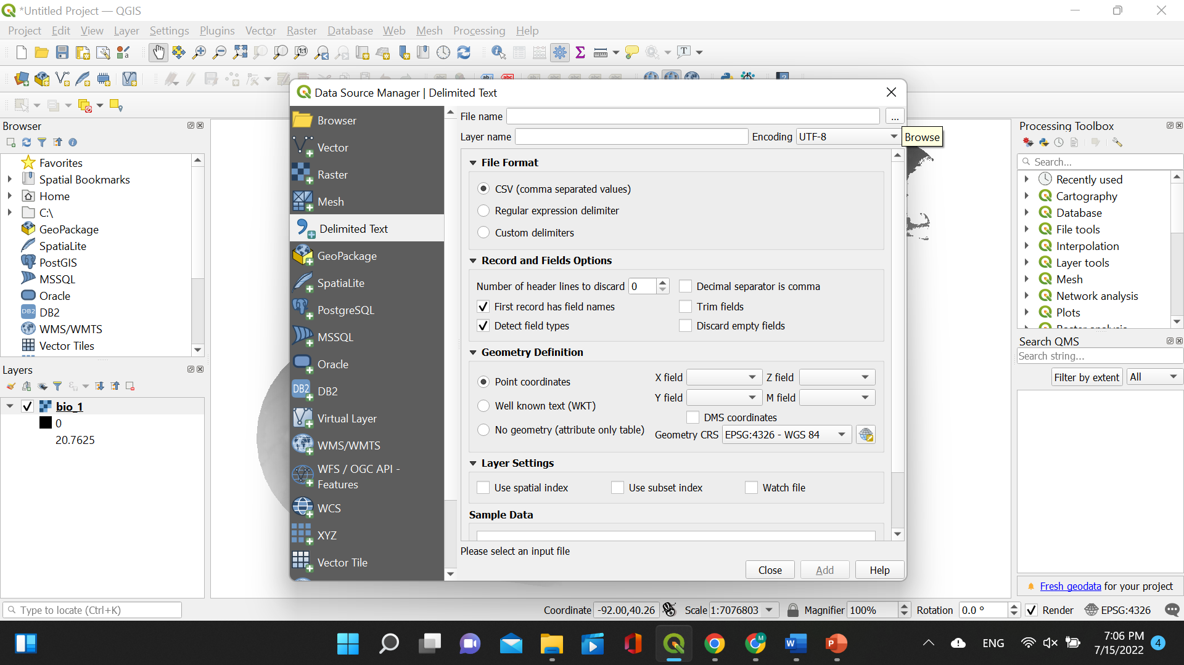
2 – Load occurrence data
A small window will pop open. Click on the three dots button after “File name”.

Slide 11
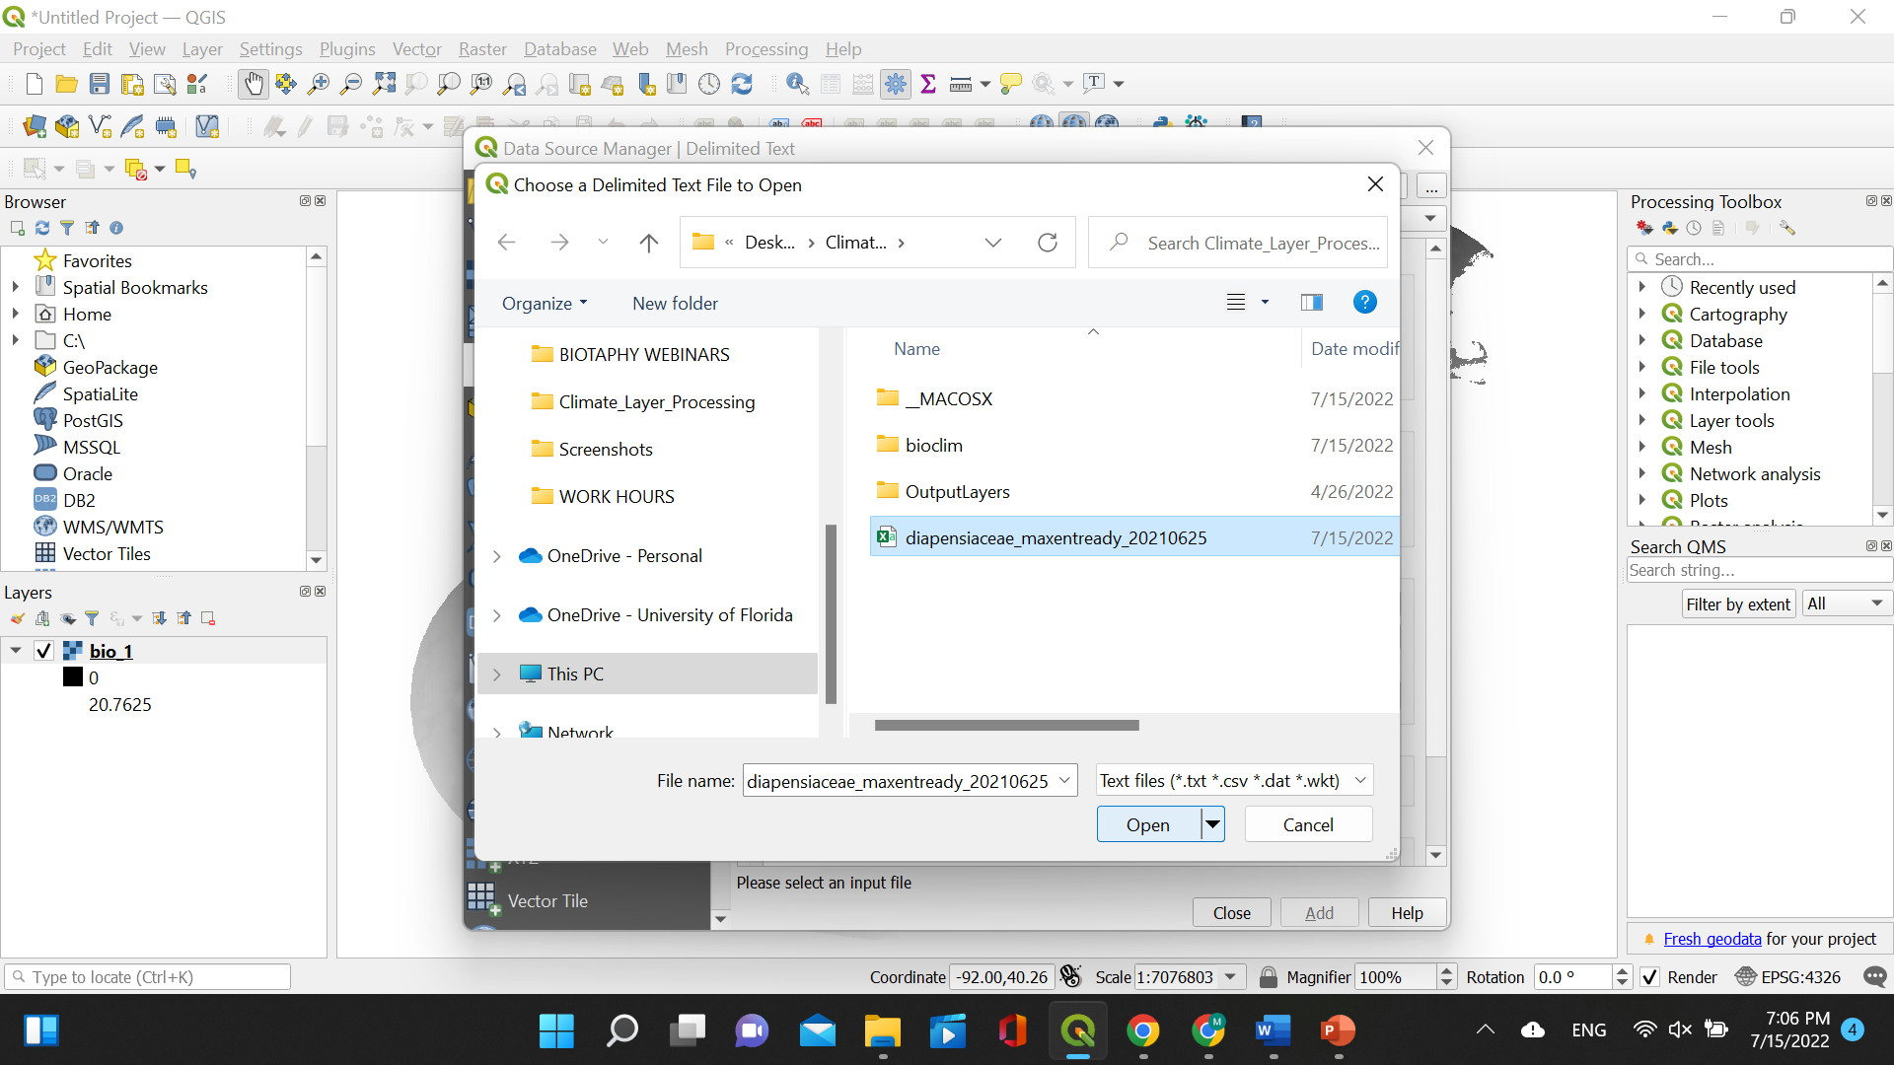
2 – Load occurrence data
Choose the occurrence file saved as .csv. For this tutorial, we will use Diapensiaceae data. Click “Open”.

Slide 12
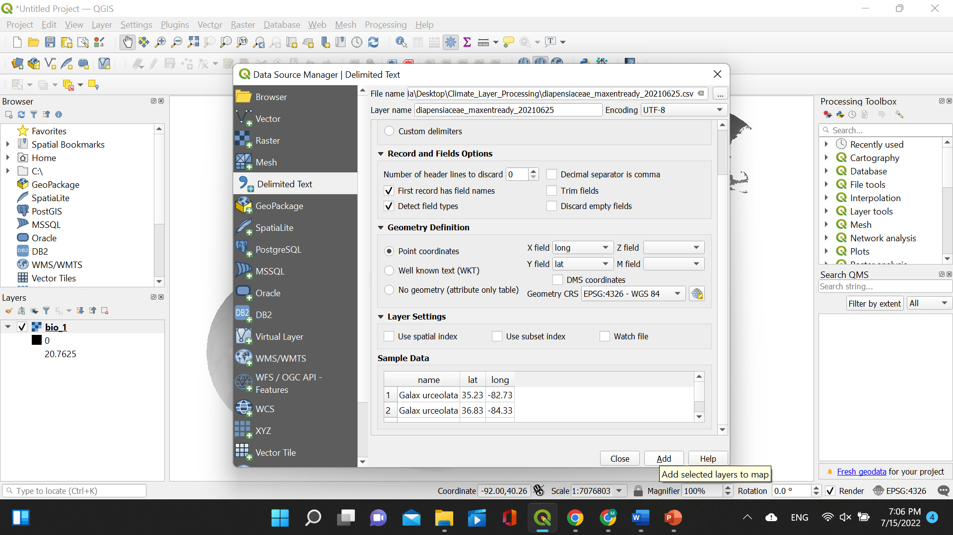
2 – Load occurrence data
Set the “X field” as longitude and the “Y field” as latitude. Make sure the “Geometry CRS” is set as EPSG:4326 – WGS 84. Click “Add”.

Slide 13
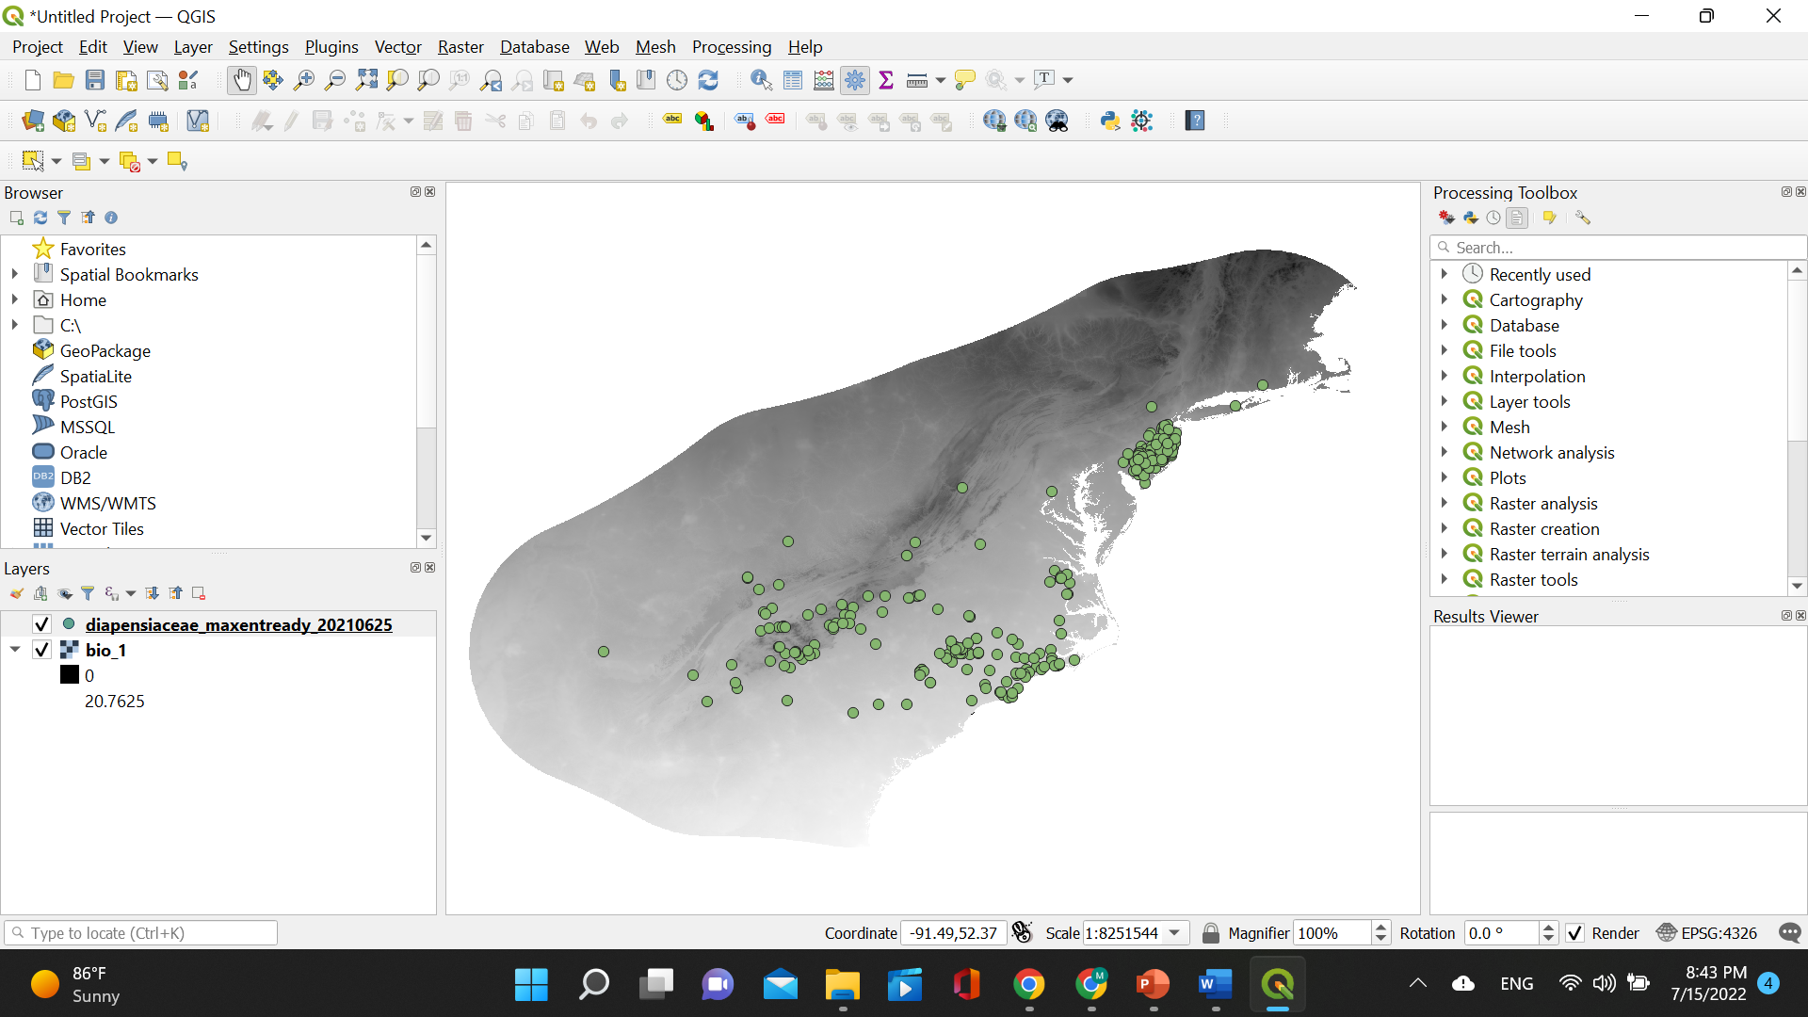
2 – Load occurrence data
The occurrences will be displayed on top of the bioclim layer. They will be listed in the window “Layers”.

Slide 14
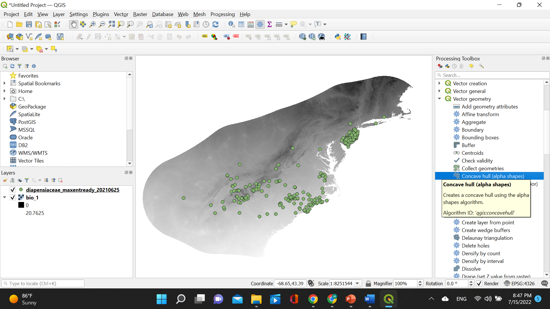
Tips when using QGIS!
You can choose which created layers you want to display.
The order of the layers matters; the oldest will always be the one on the bottom!
Also, the colors of the layers will change as well depending on the machine and iteration!

Slide 15
3 – Create alpha hull
On the right side of your screen within the “Processing Toolbox” click “Vector geometry” and then “Concave hull (alpha shapes)”.

Slide 16
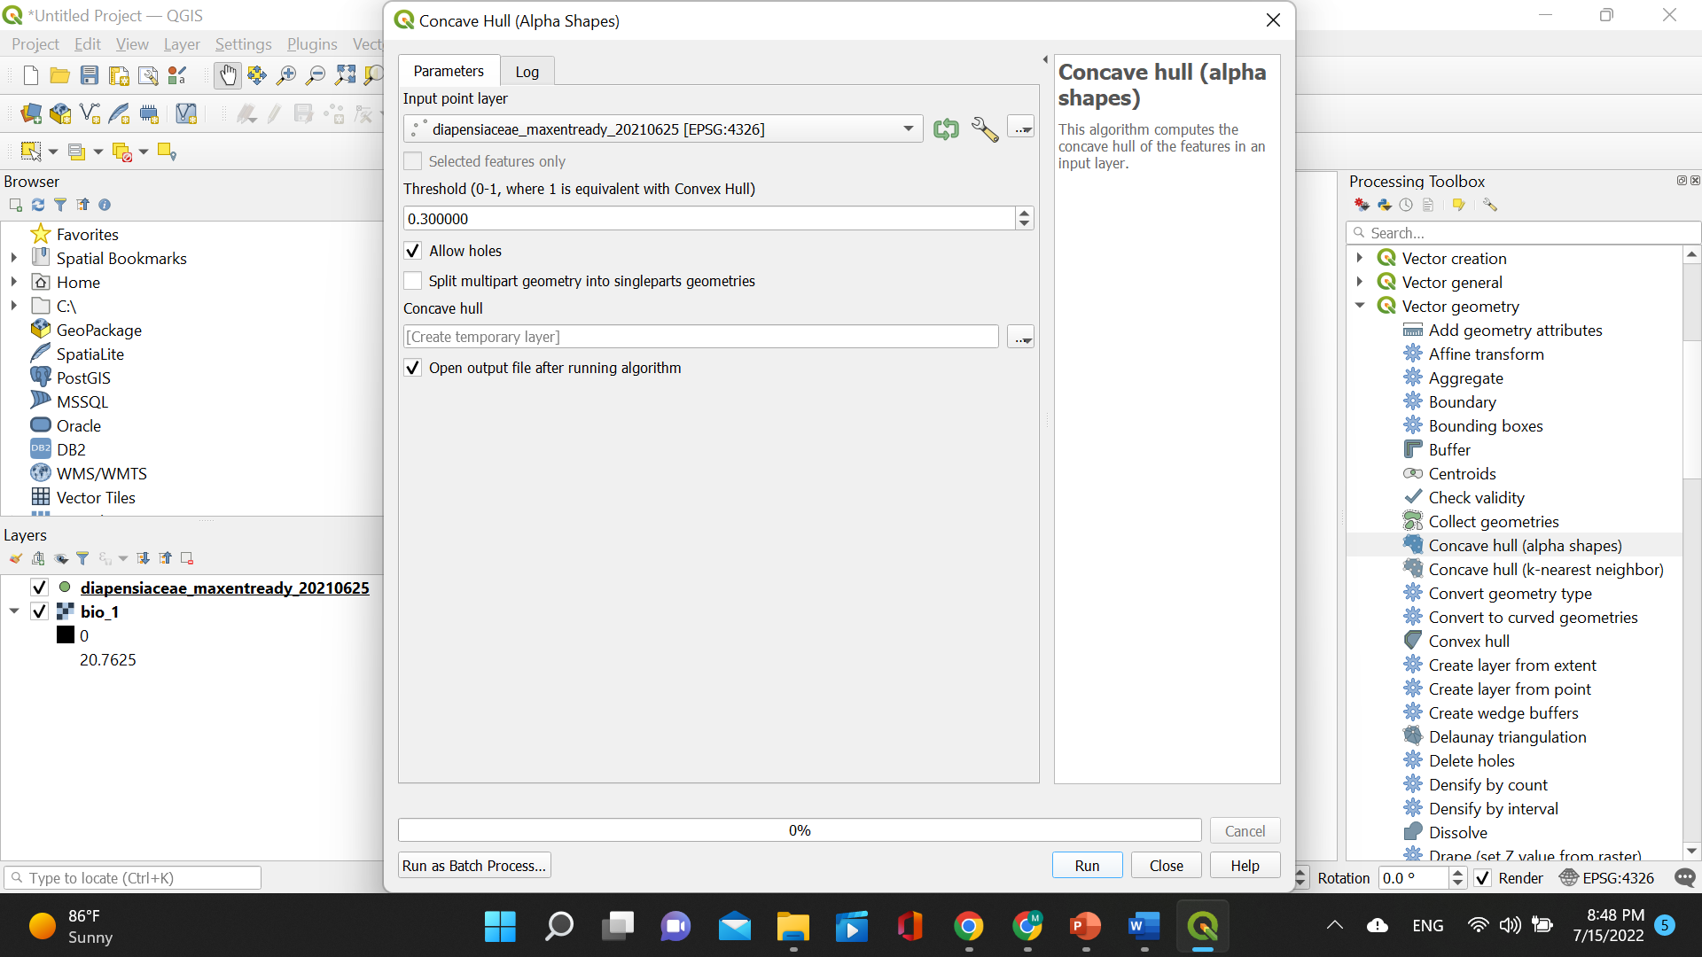
3 – Create alpha hull
Make sure to set the threshold to 1!
A small window will pop open. Choose the occurrence data layer under “Input point layer”, set threshold to 1, and click “Run”.

Slide 17
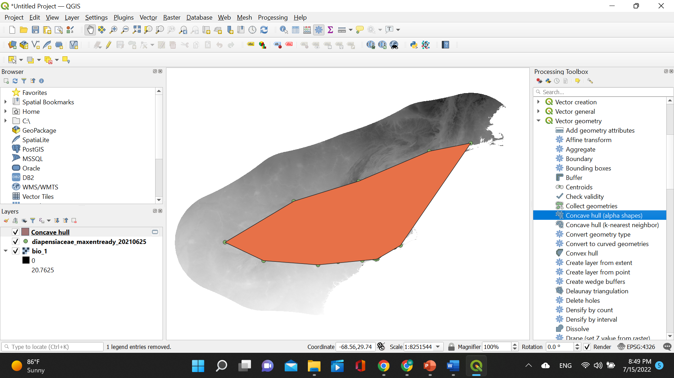
3 – Create alpha hull
The concave alpha hull will be displayed as a layer (here in orange) on top of the two previous layers.

Slide 18
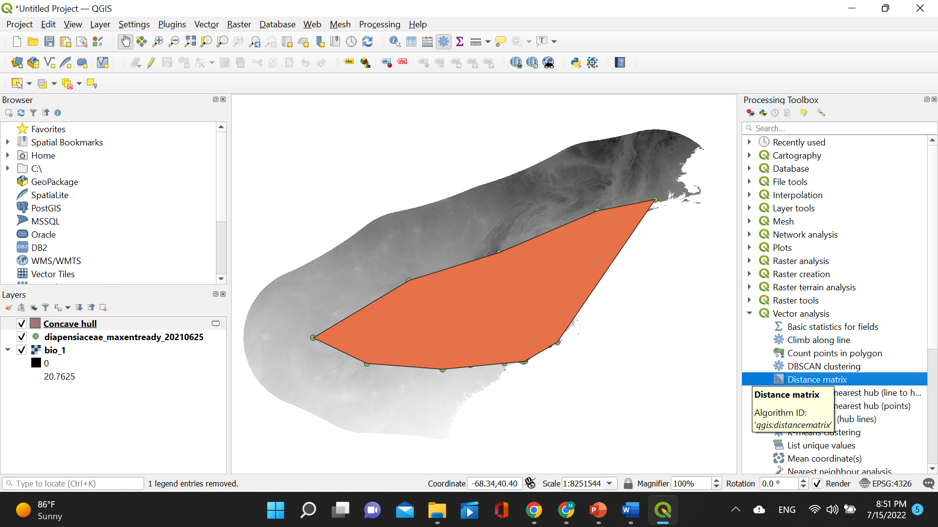
4 – Calculate distance matrix
Under “Processing Toolbox” click “Vector analysis” and then “Distance matrix”.

Slide 19
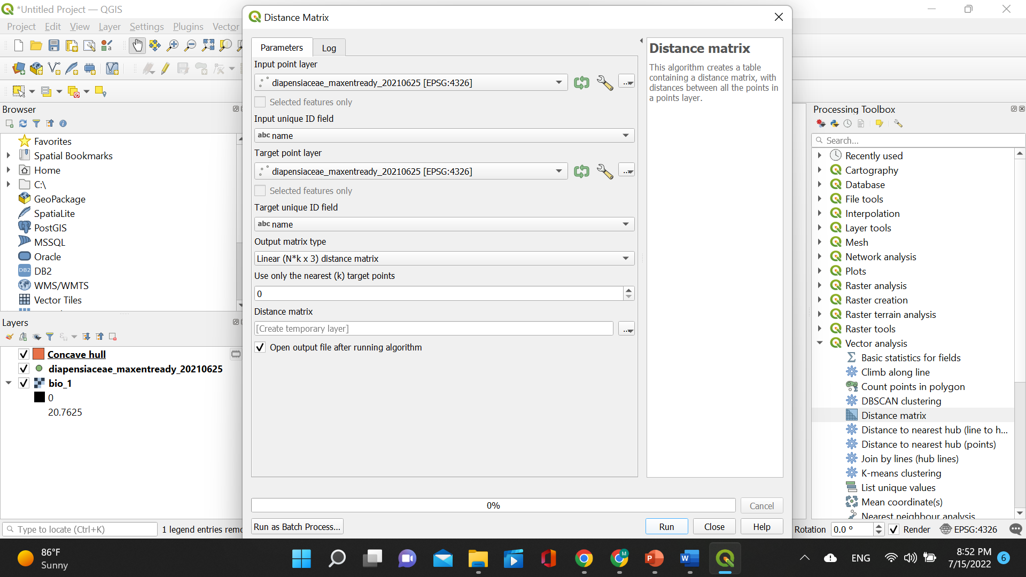
4 – Calculate distance matrix
A small window will pop open. Choose the occurrence data layer for “Input point layer” and “Target point layer”. Then choose abc name for “Input unique ID field” and “Target unique ID field”. Click “Run”.

Slide 20
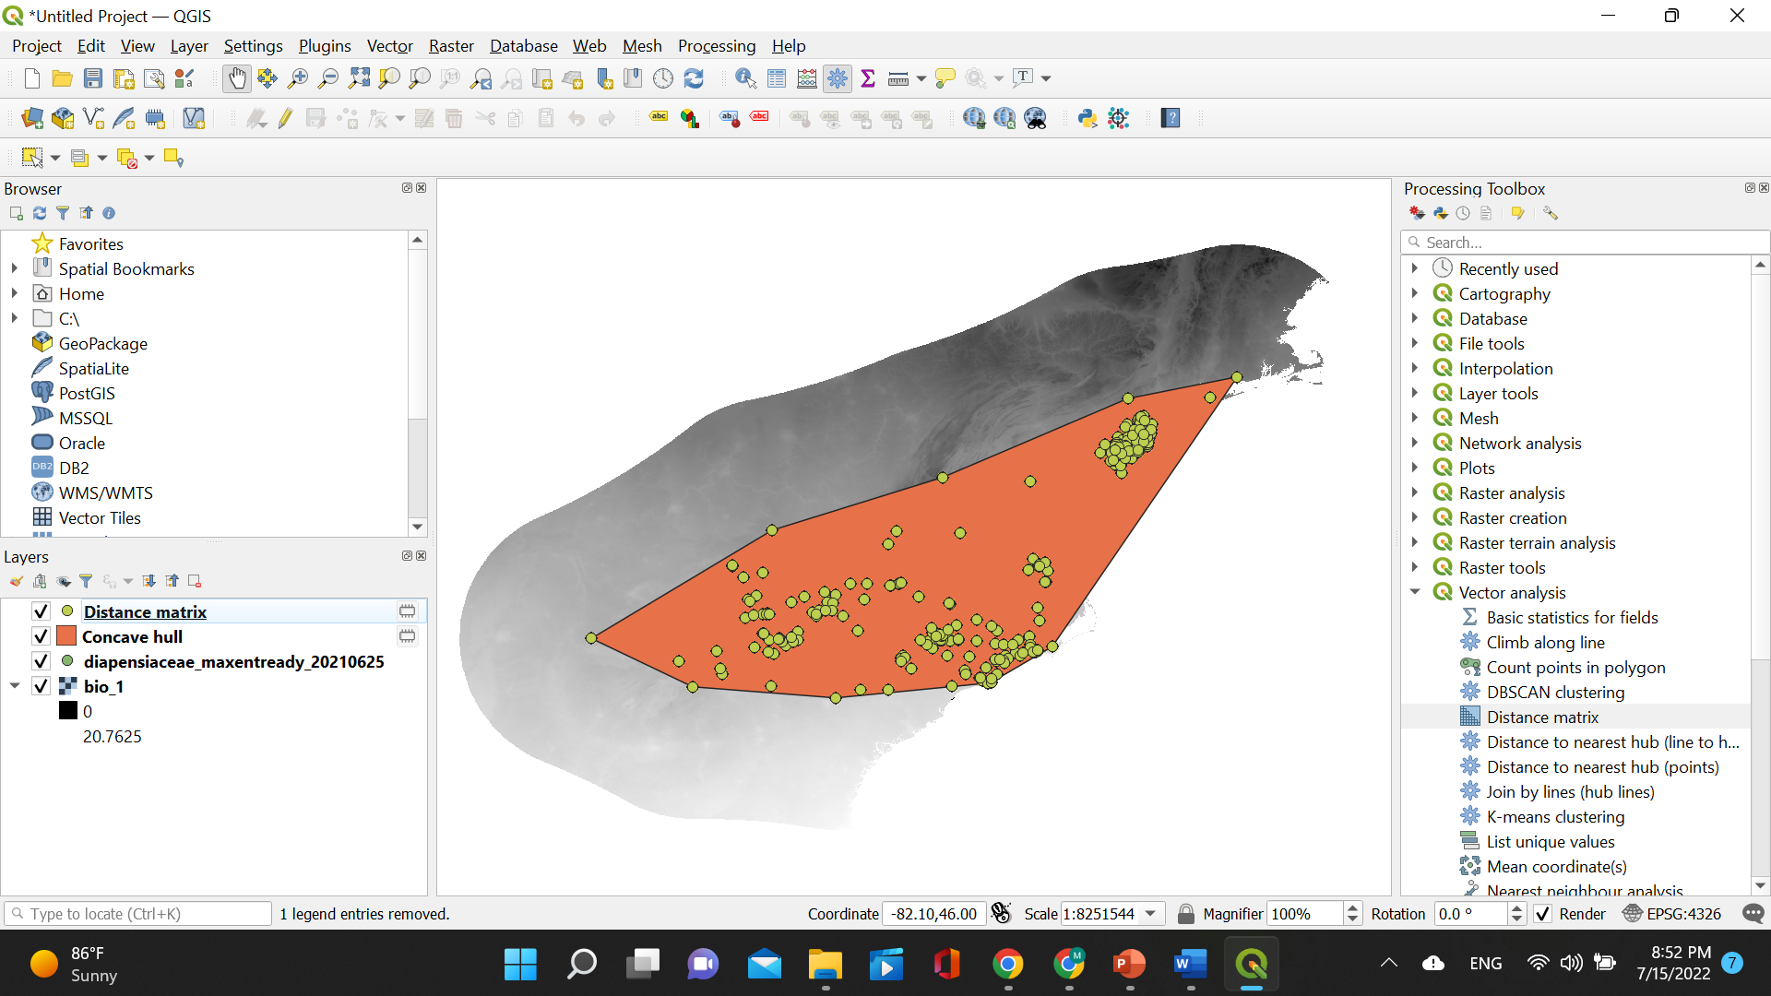
4 – Calculate distance matrix
The distance matrix will be displayed as a layer (here in green) on top of the three previous layers.

Slide 21
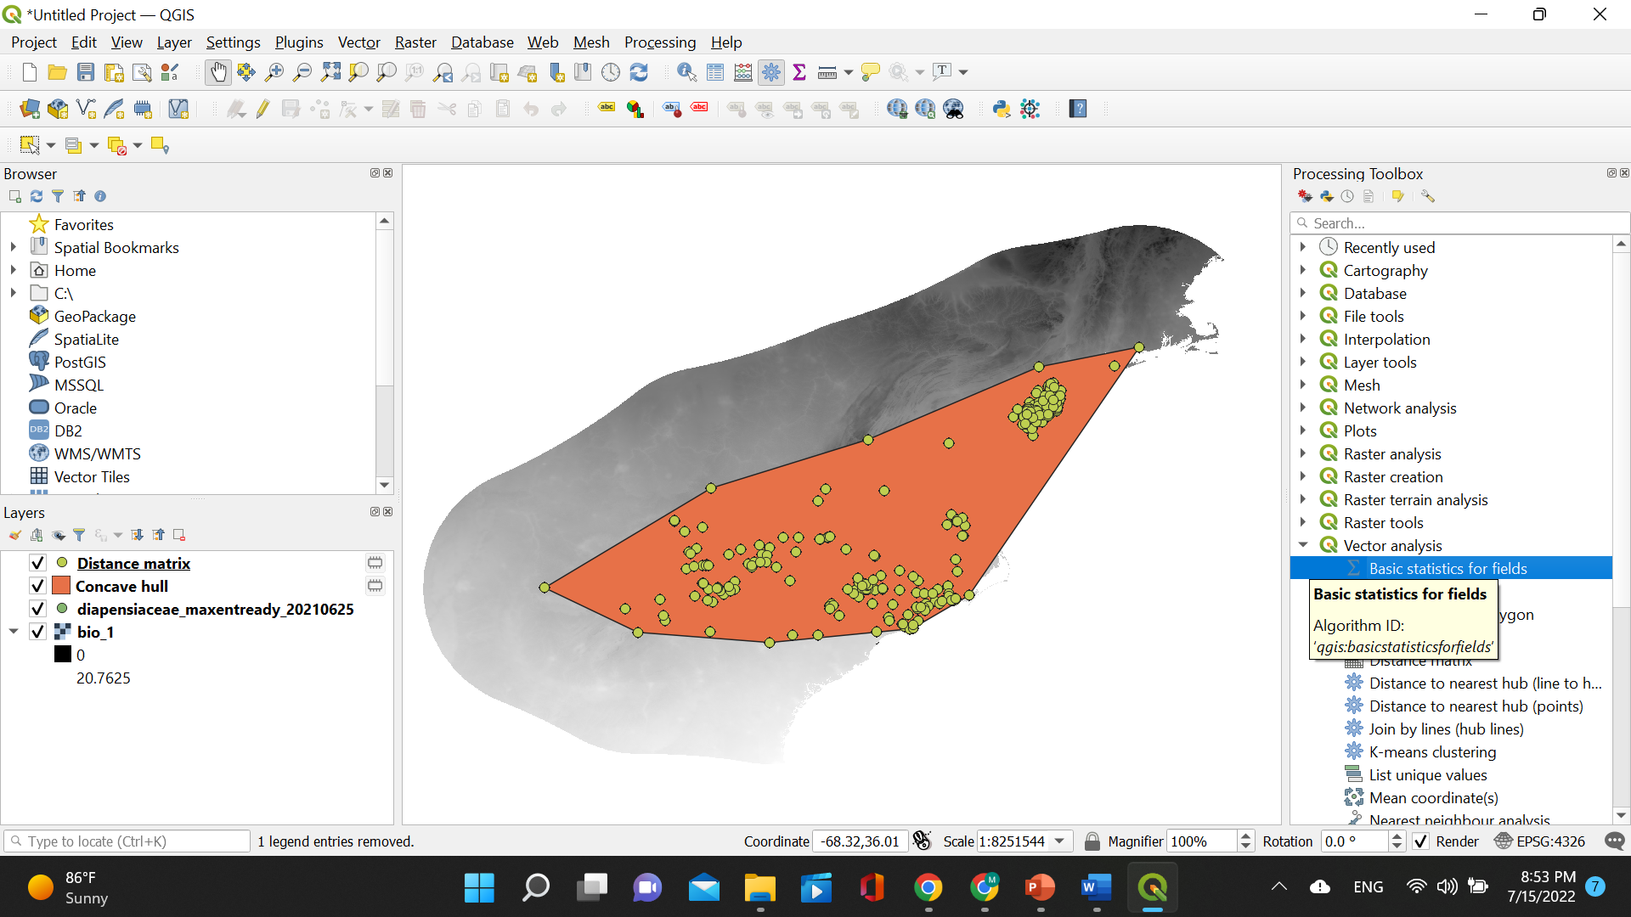
5 – Calculate basic statistics for buffer
Under “Processing Toolbox” click “Vector analysis” and then “Basic statistics for fields”.

Slide 22
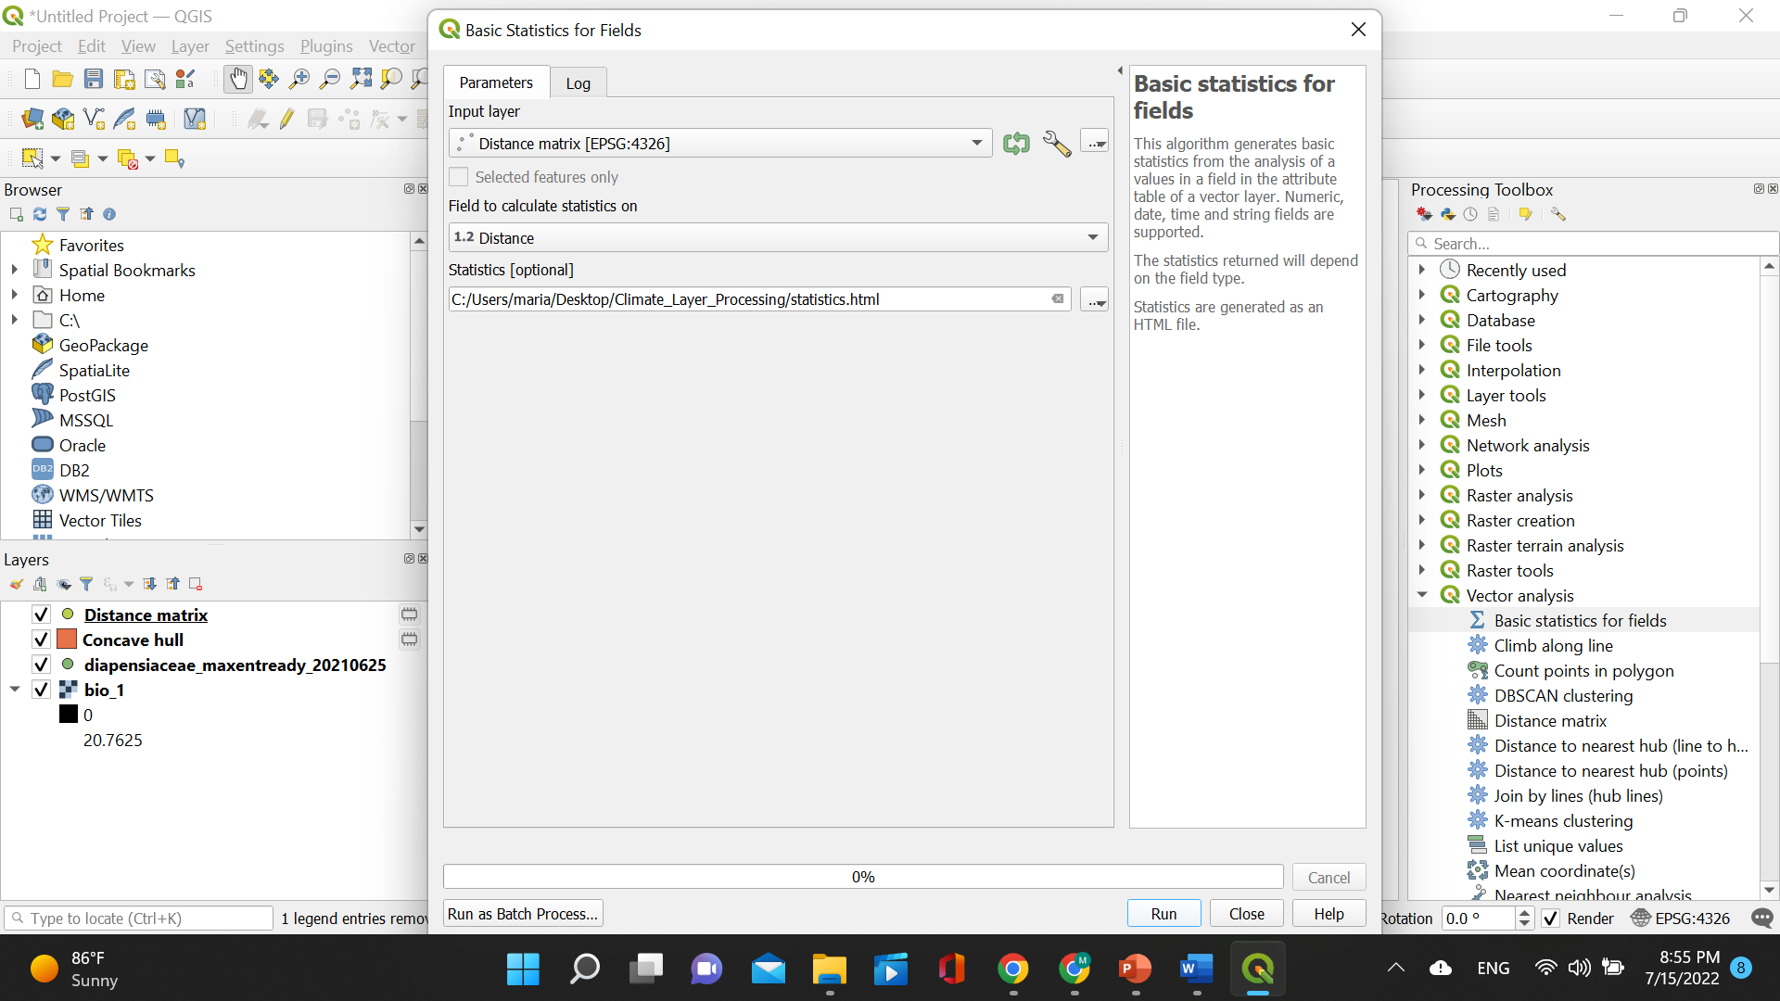
5 – Calculate basic statistics for buffer
A small window will pop open. Choose the distance matrix layer for “Input layer” and the last column Distance for “Field to calculate statistics on”. Then click on the three dots under “Statistics” and click “Save to File” and choose a name and a path to save your file.

Slide 23
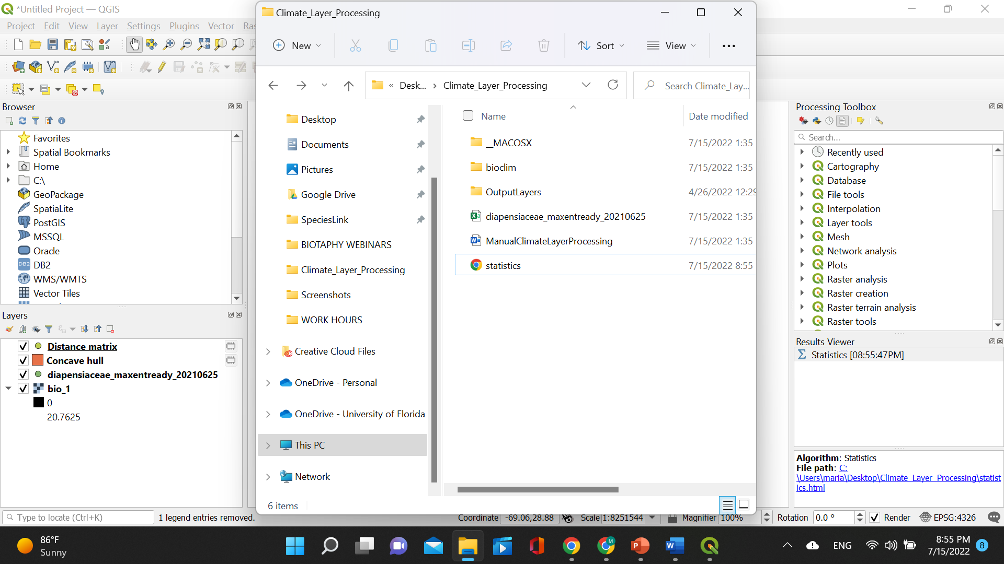
5 – Calculate basic statistics for buffer
Check to see if the calculated statistics have been saved in the appropriate path. They are saved as an .html file.

Slide 24
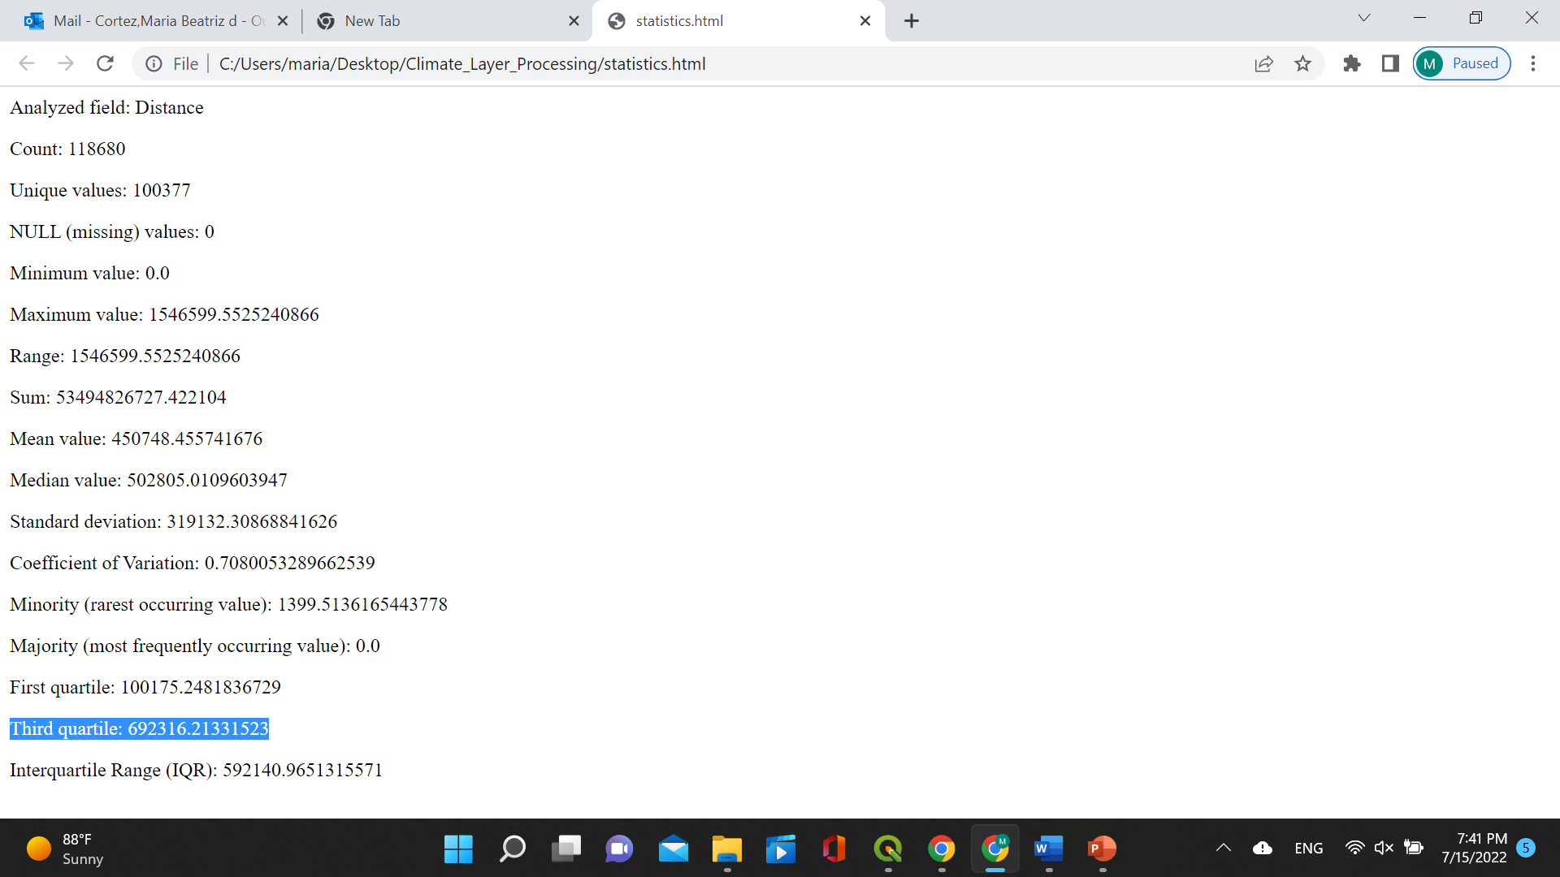
5 – Calculate basic statistics for buffer
Open the file and see all the different statistics that have been calculated. We will use the value for the “Third quartile” as our buffer.
These statistics will not show up as an extra layer on QGIS.

Slide 25
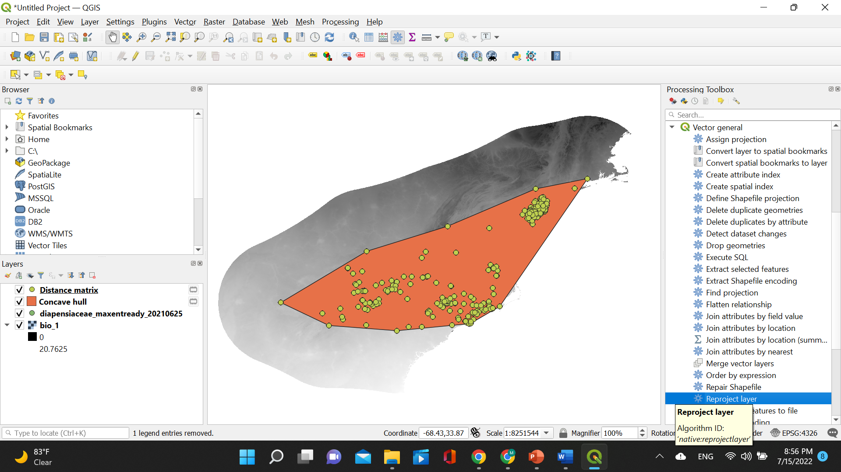
6 – Reproject layer
Under “Processing Toolbox” click “Vector general” and then “Reproject layer”.

Slide 26
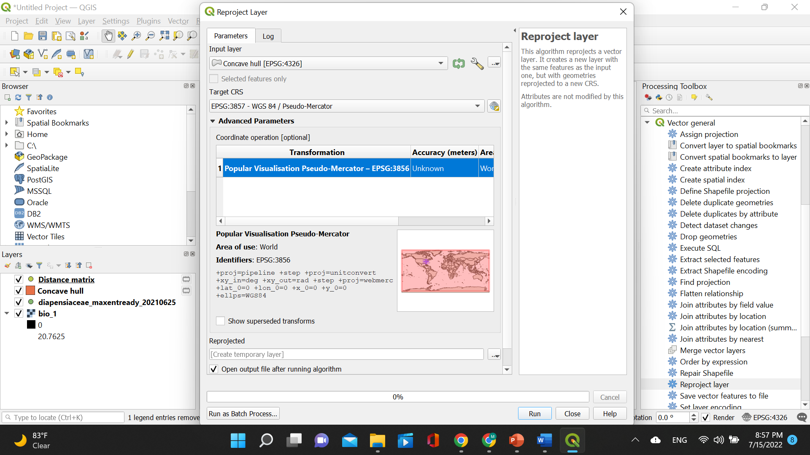
6 – Reproject layer
A small window will pop open. Choose the concave hull layer for “Input layer” and set the “Target CRS” as EPSG:3857 – WGS 84 / Pseudo-Mercator. Then click “Run”.

Slide 27
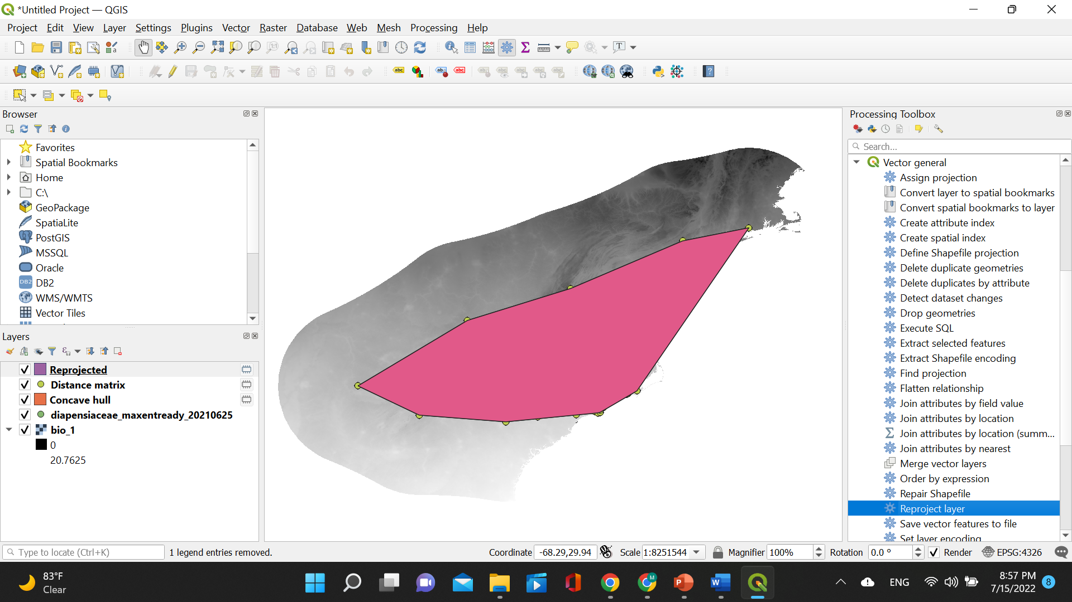
6 – Reproject layer
The reprojected layer will be displayed (here in pink) on top of the four previous layers.

Slide 28
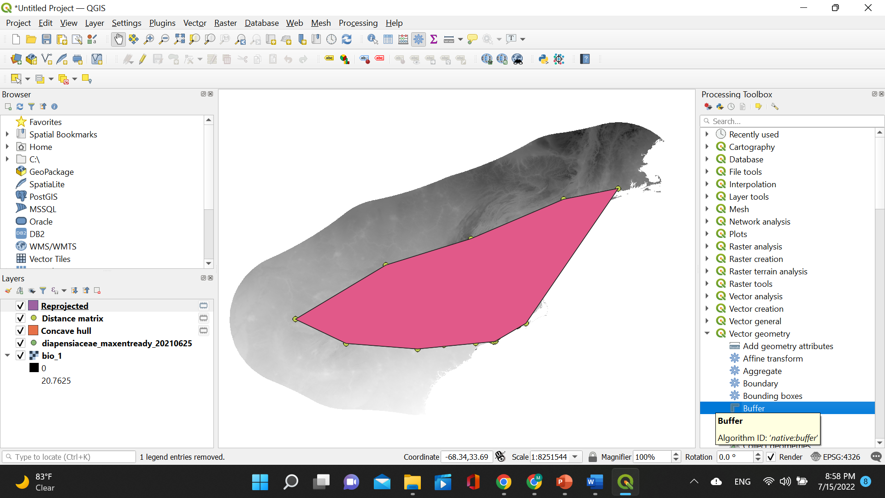
6 – Reproject layer
Under “Processing Toolbox” click “Vector geometry” and then “Buffer”.

Slide 29
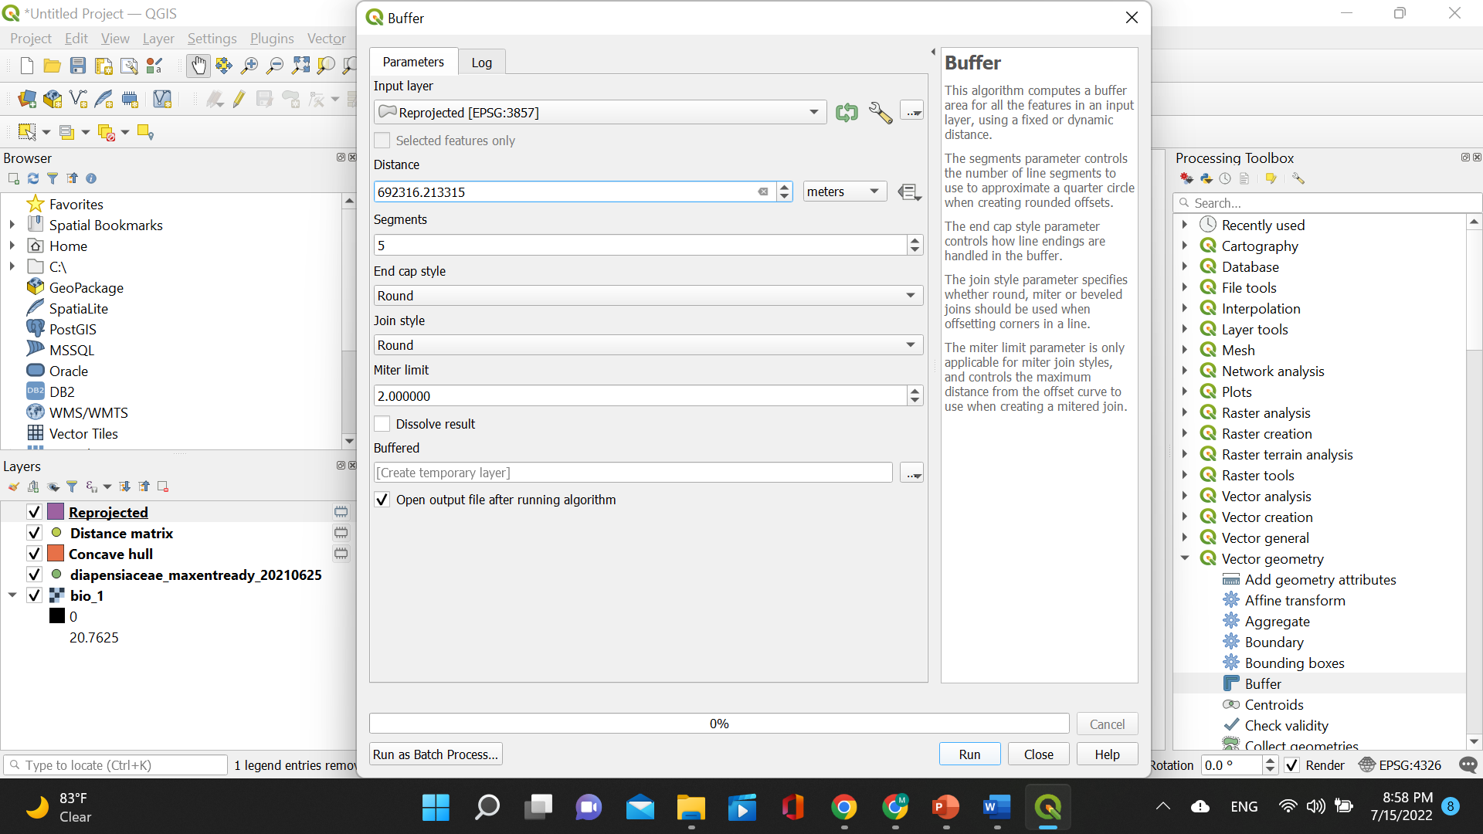
6 – Reproject layer
A small window will pop open. Choose the reprojected layer for “Input layer” and set the “Distance” to the value found for the “Third quartile” (in this case 692316.21331523). Then click “Run”.

Slide 30
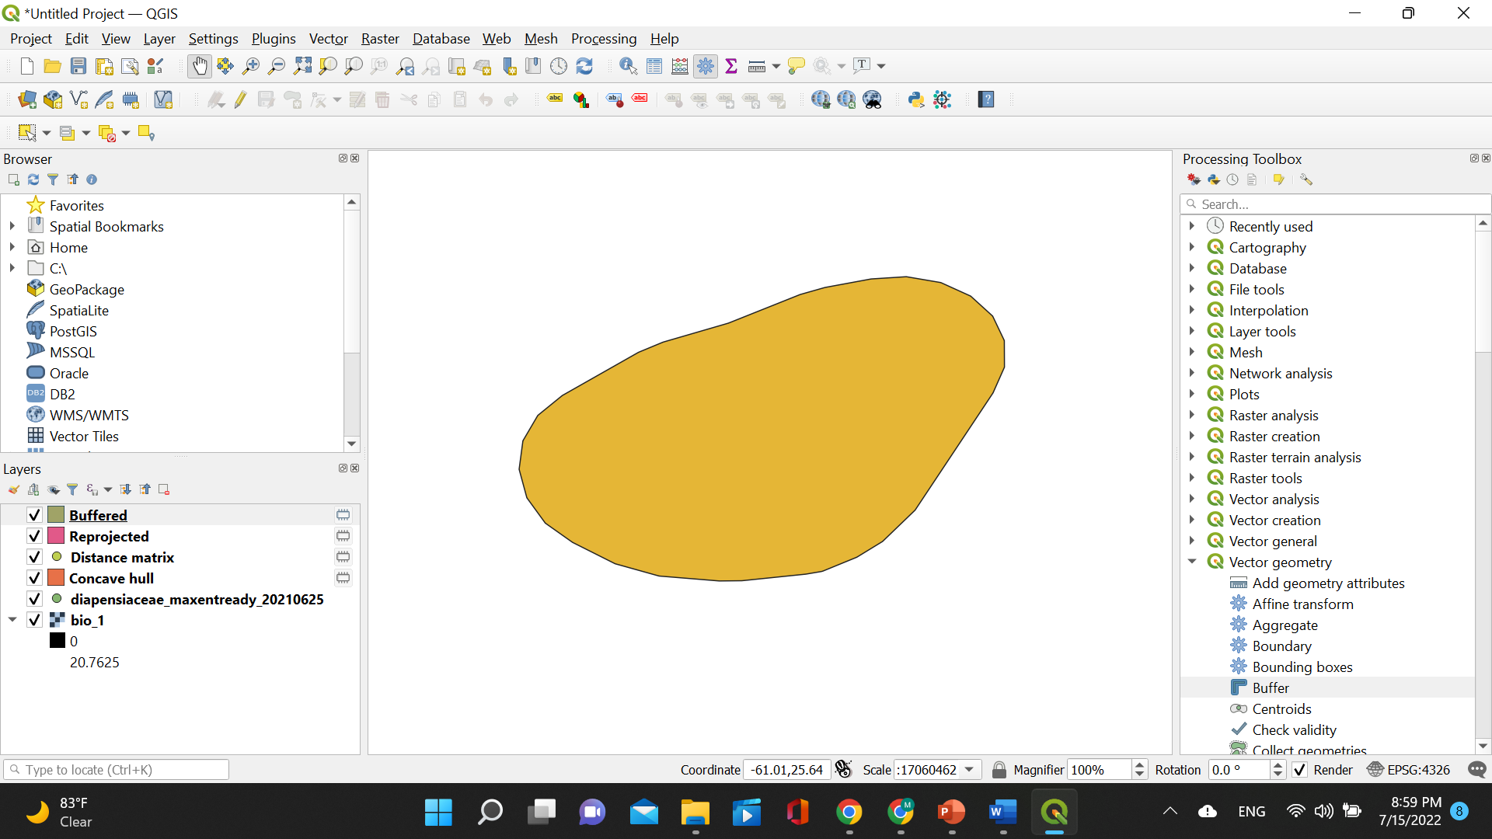
7 – Create buffer
The buffered layer will be displayed (here in yellow) on top of the five previous layers.

Slide 31
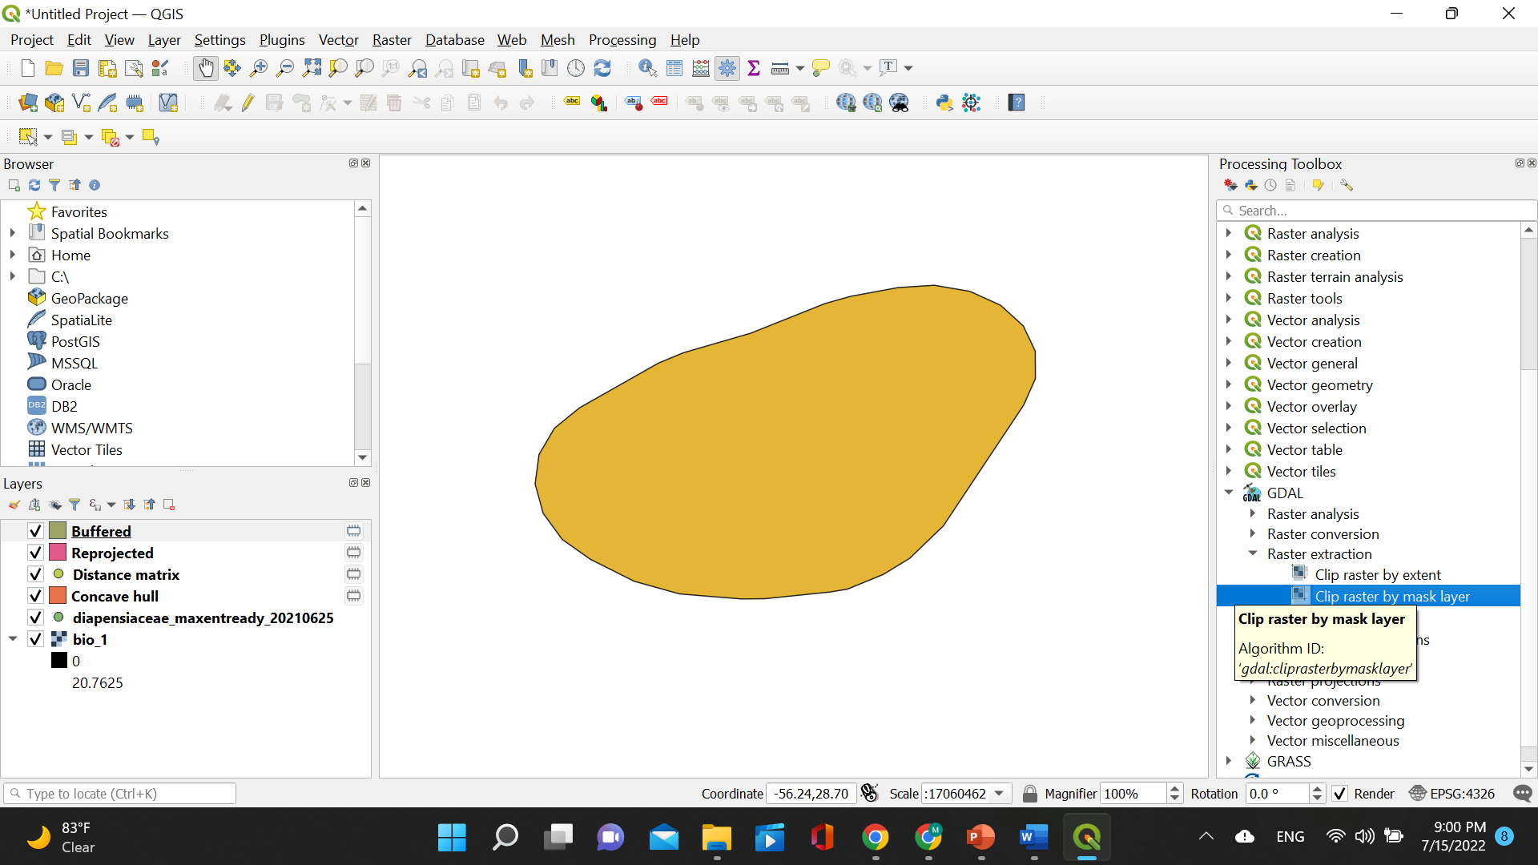
8 – Create clipped mask
Under “Processing Toolbox” click “GDAL”, “Raster extraction”, and then “Clip raster by mask layer”.

Slide 32
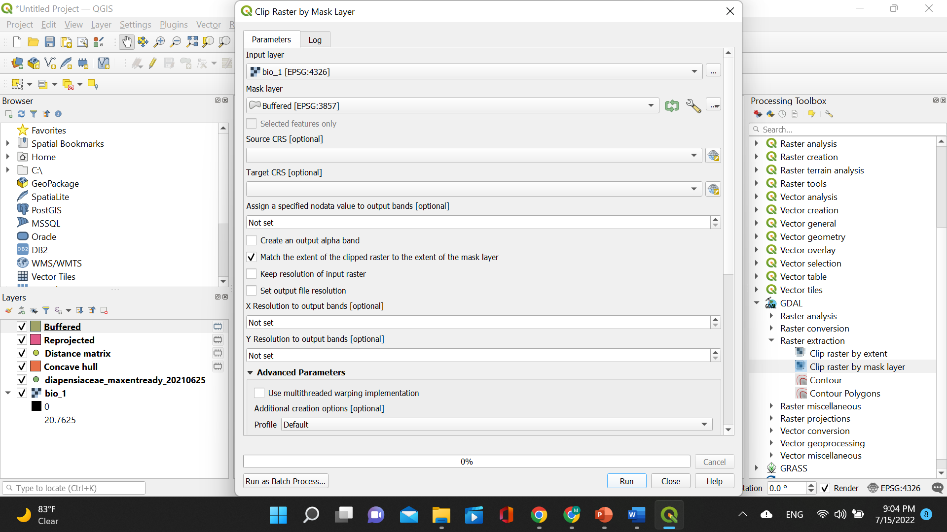
8 – Create clipped mask
A small window will pop open. Choose the bioclim layer for “Input layer” and the buffered layer for “Mask layer”. Then click “Run”.

Slide 33
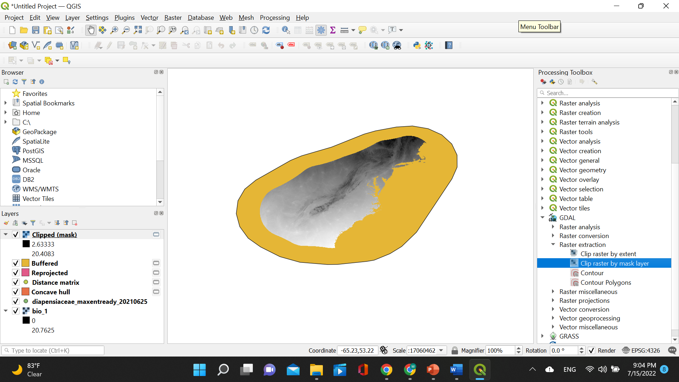
Visualizing clipped mask
The clipped layer will be displayed on top of the six previous layers.

Slide 34
8 – Create clipped mask
Alternatively, you can choose to clip all the layers at once. When the window pops open, you just click on “Run as Batch Process”!

Slide 35
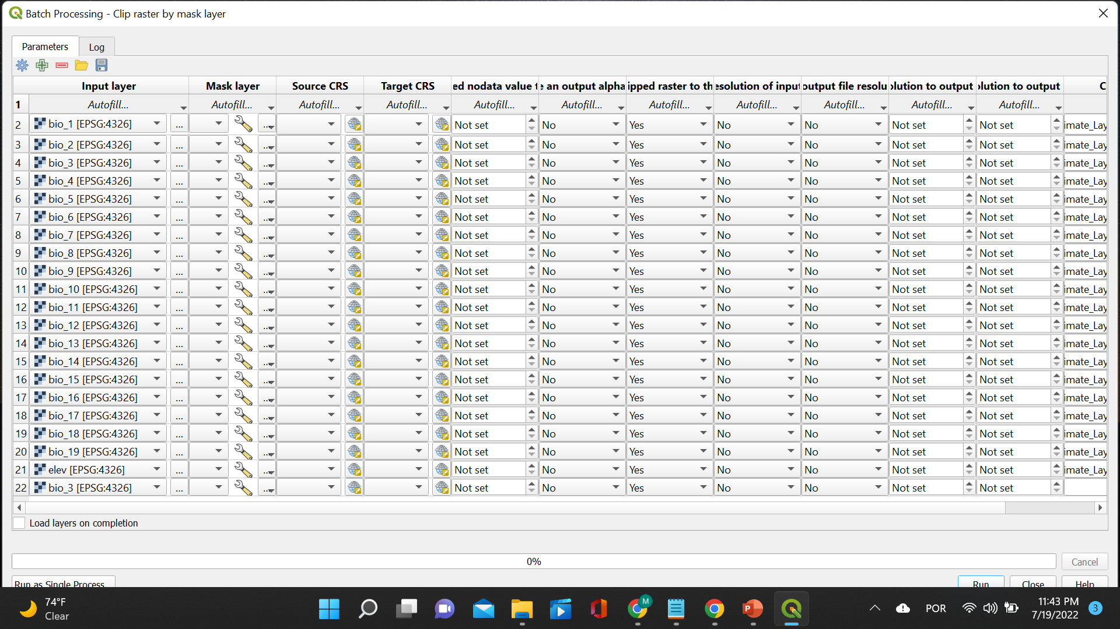
8 – Create clipped mask
Add slide with print screen of running batch mode for clipping all the layers at once
Now, insert all the bioclim layers under “Input layer” and the buffered layer under “Mask”. You are using the same mask for all the layers! Make sure you have all the bioclim layers loaded to QGIS. You can load all of them at once by using Autofill and selecting from the folder where they are located!

Slide 36
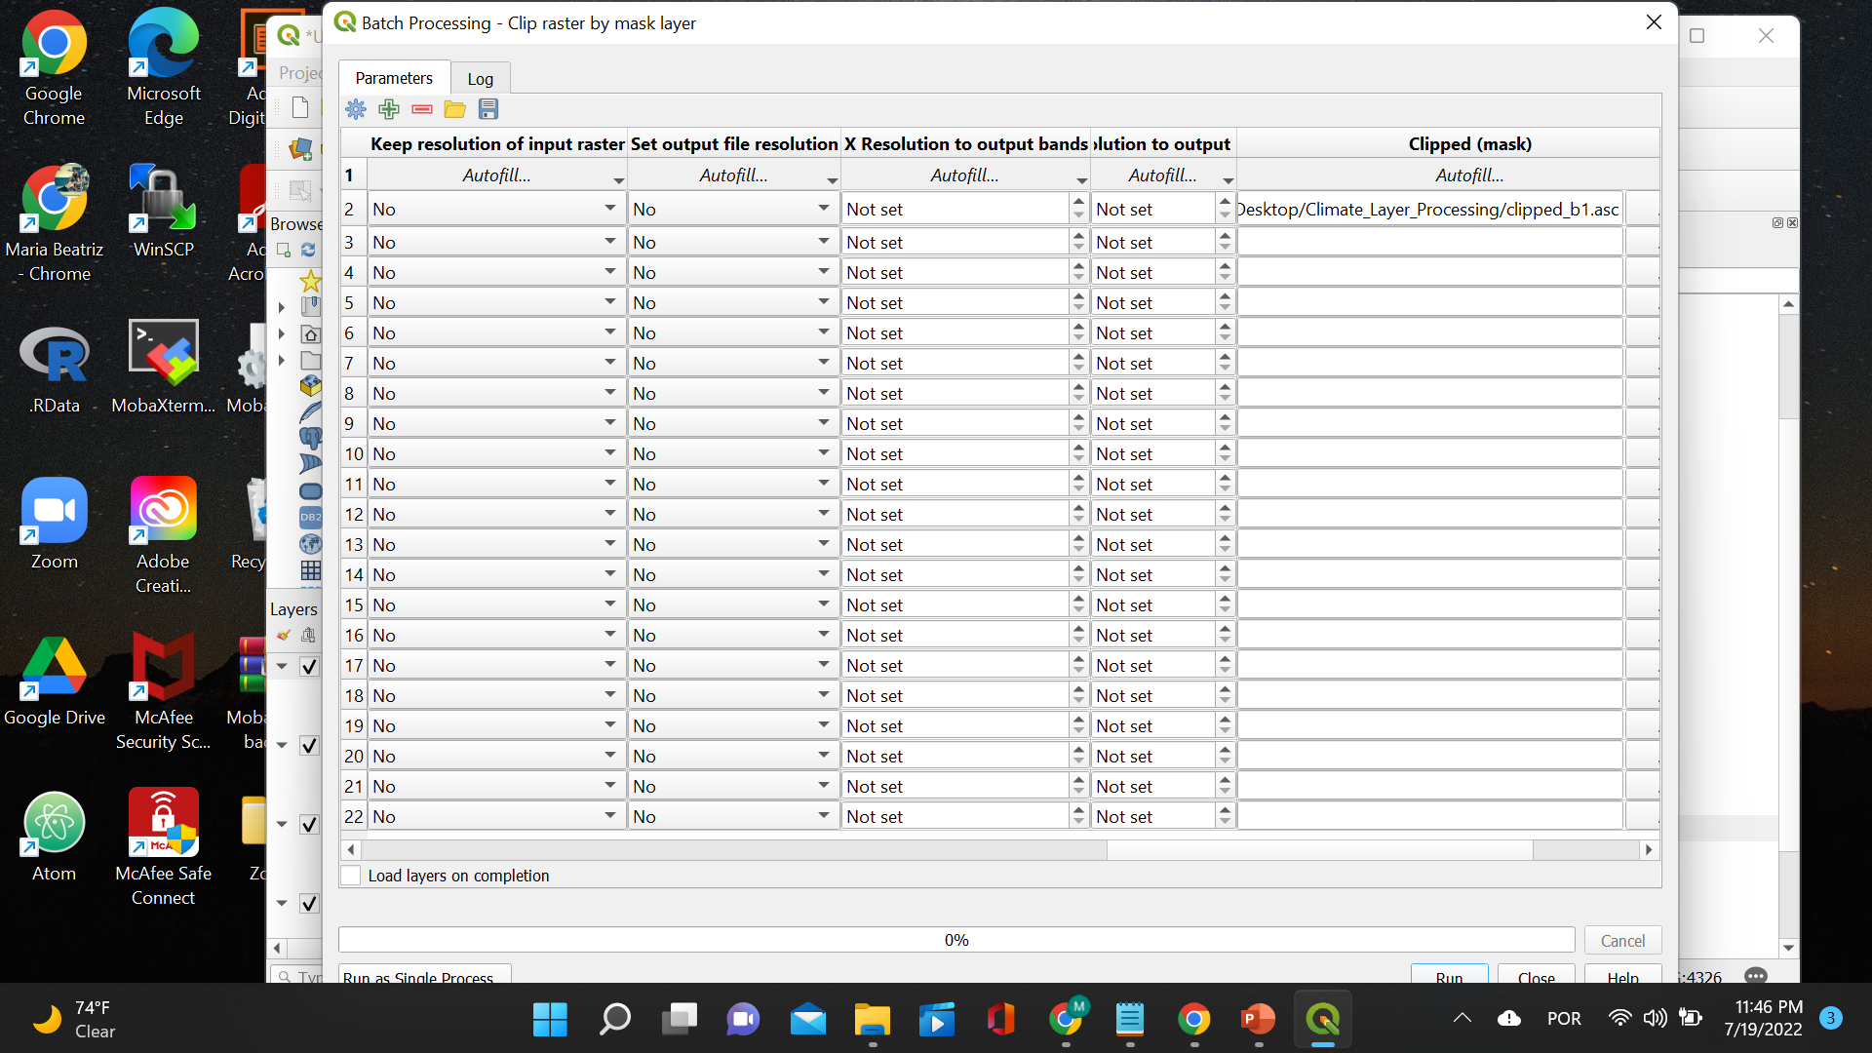
8 – Create clipped mask
The last thing you need to do is save these clipped bioclim layers as .asc files so that they can be loaded in MaxEnt later on!

Slide 37
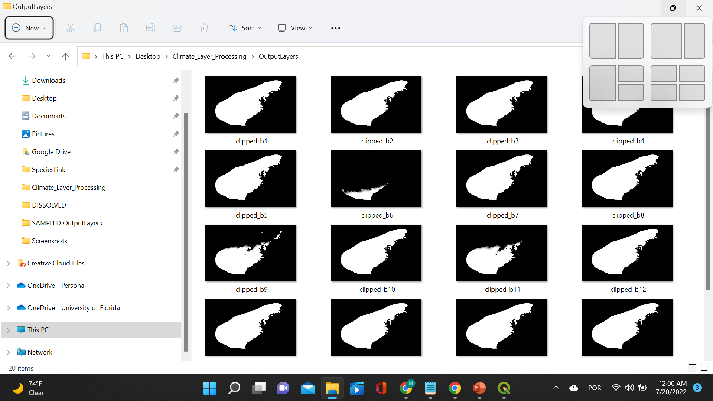
Visualizing original bioclim mask (for comparison)
Here are the clipped bioclim layers!

Slide 38
Outline of processing layers with QGIS
9 – Vectorize clipped bioclim layer (creating mask)
10 – Fix geometries of the vector (creating mask)
11 – Dissolve the vector (creating mask)
12 – Create random points
13 – Sample all clipped rasters (save as .csv)
14 – Calculate correlation
15 – Eliminate correlated layers randomly

Slide 39
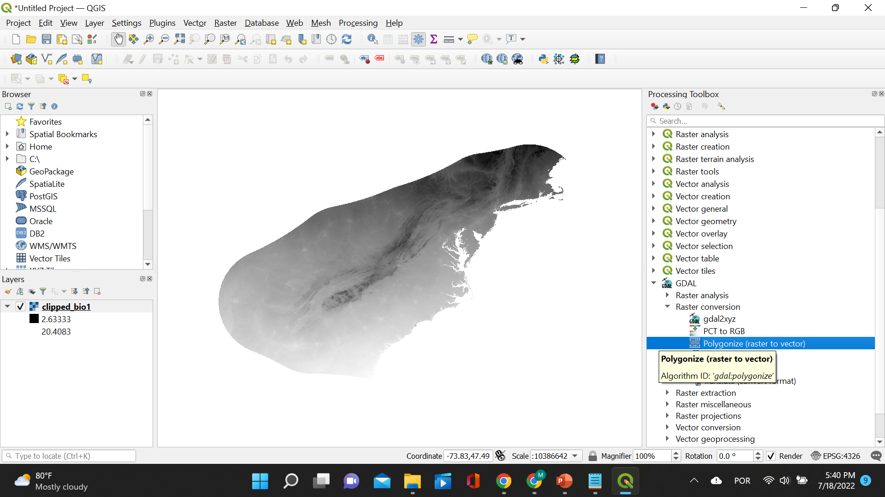
9 – Vectorize clipped bioclim layer
Under “Processing Toolbox” click “GDAL” and then “Polygonize (raster to vector)”.

Slide 40
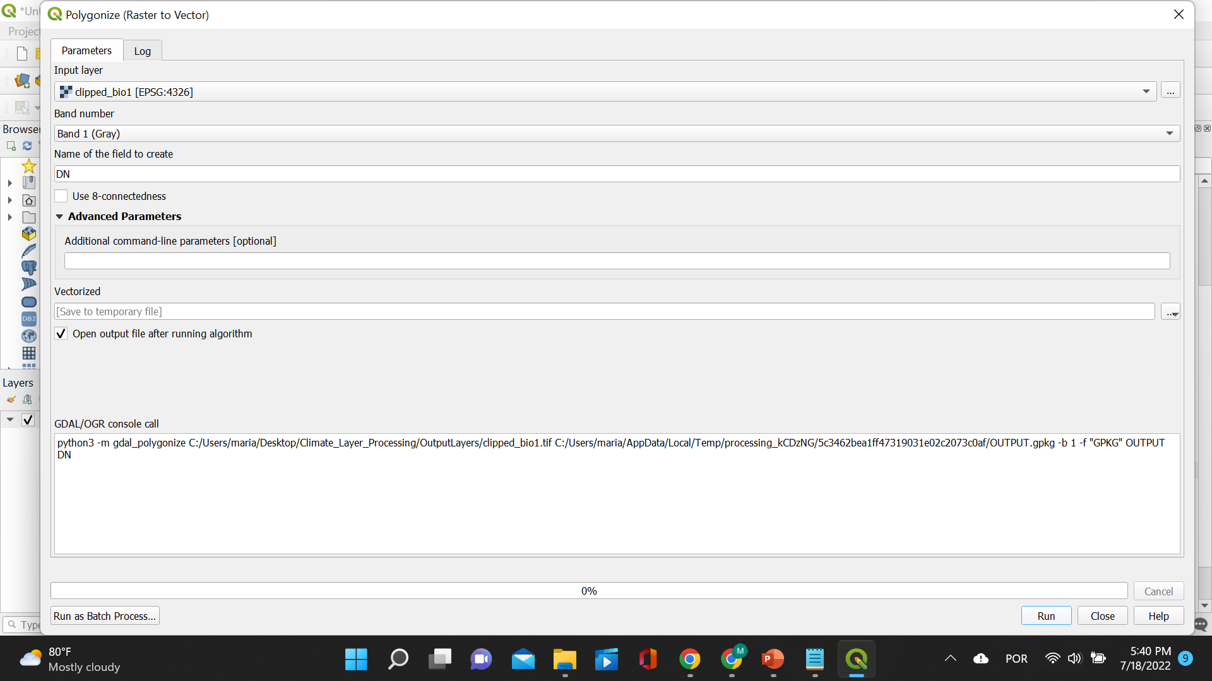
9 – Vectorize clipped bioclim layer
A small window will pop open. Choose the clipped bioclim layer under “Input layer” and save the resulting file as .shp. Then click “Run”.

Slide 41
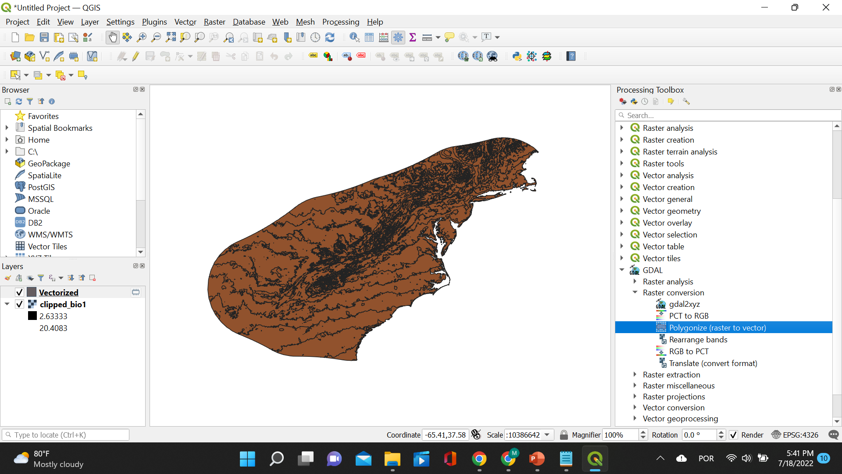
9 – Vectorize clipped bioclim layer
The vectorized layer will be displayed on top of the clipped bioclim layer.

Slide 42
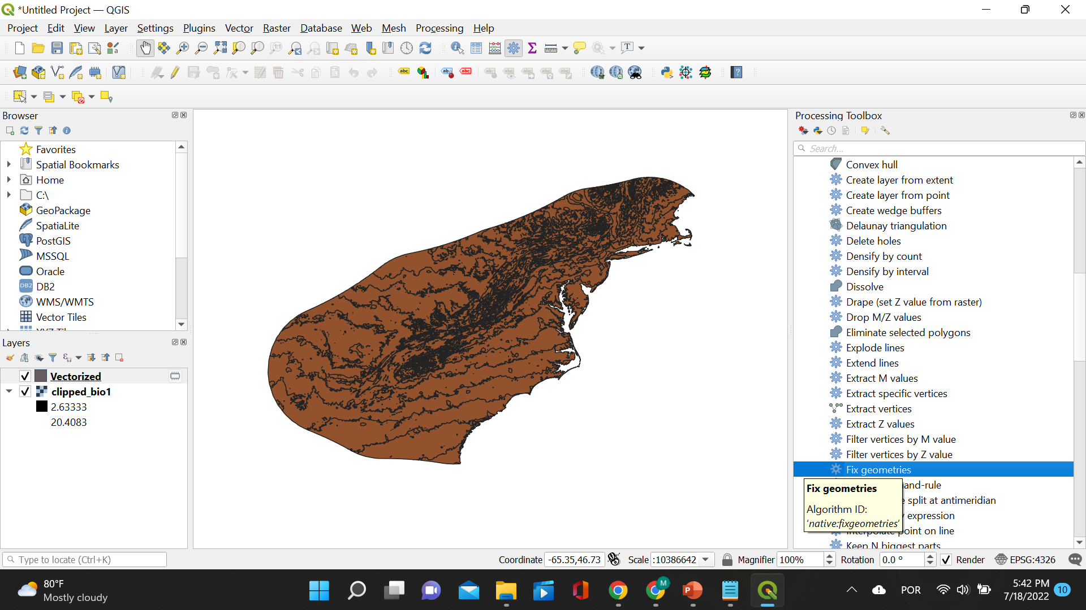
10 – Fix geometries of the vector
Under “Processing Toolbox” click “Vector geometry” and then “Fix geometries”.

Slide 43
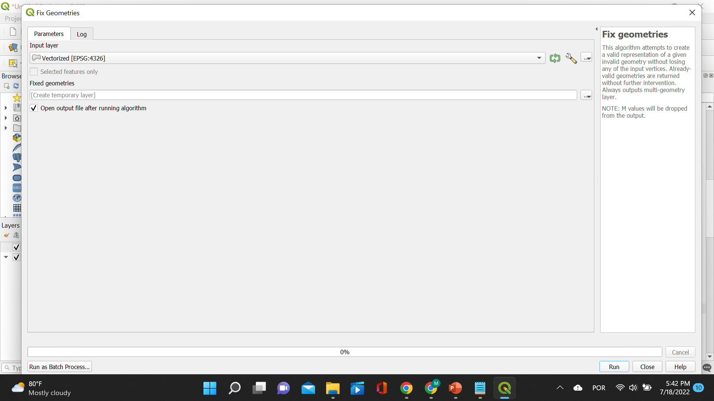
10 – Fix geometries of the vector
A small window will pop open. Choose the vectorized layer under “Input layer” and save the resulting file as .shp. Then click “Run”.

Slide 44
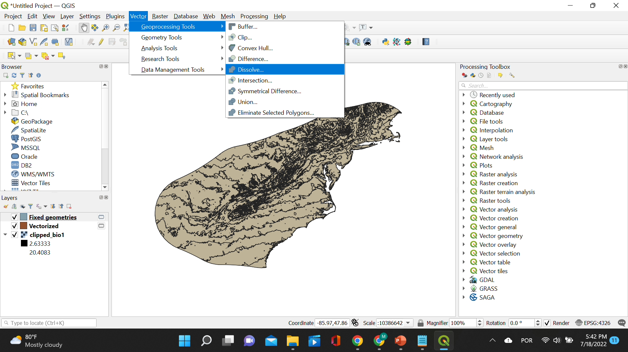
11 – Dissolve the vector
The fixed geometry layer will be displayed on top of the other layers. Now, click “Vector”, “Geoprocessing Tools”, and then “Dissolve”.

Slide 45
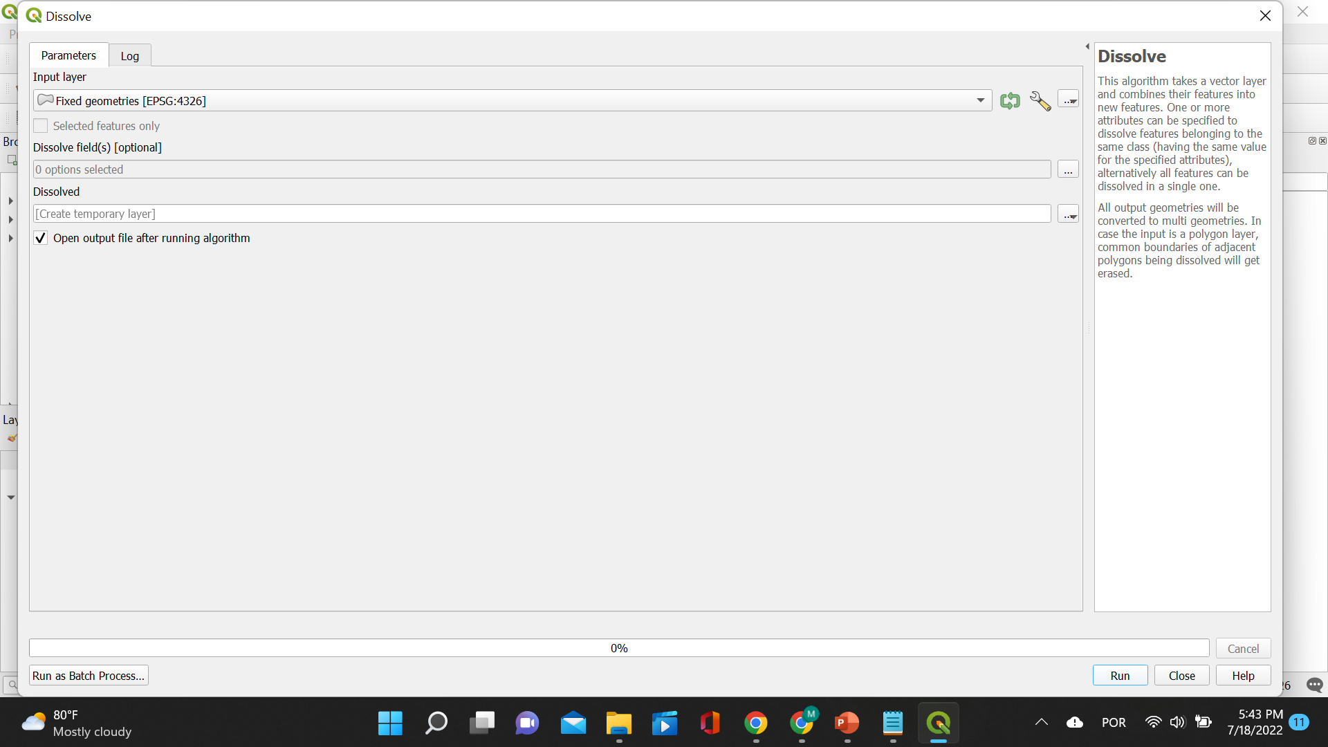
11 – Dissolve the vector
A small window will pop open. Choose the fixed geometries layer under “Input layer” and save the resulting file as .shp. Then click “Run”.

Slide 46
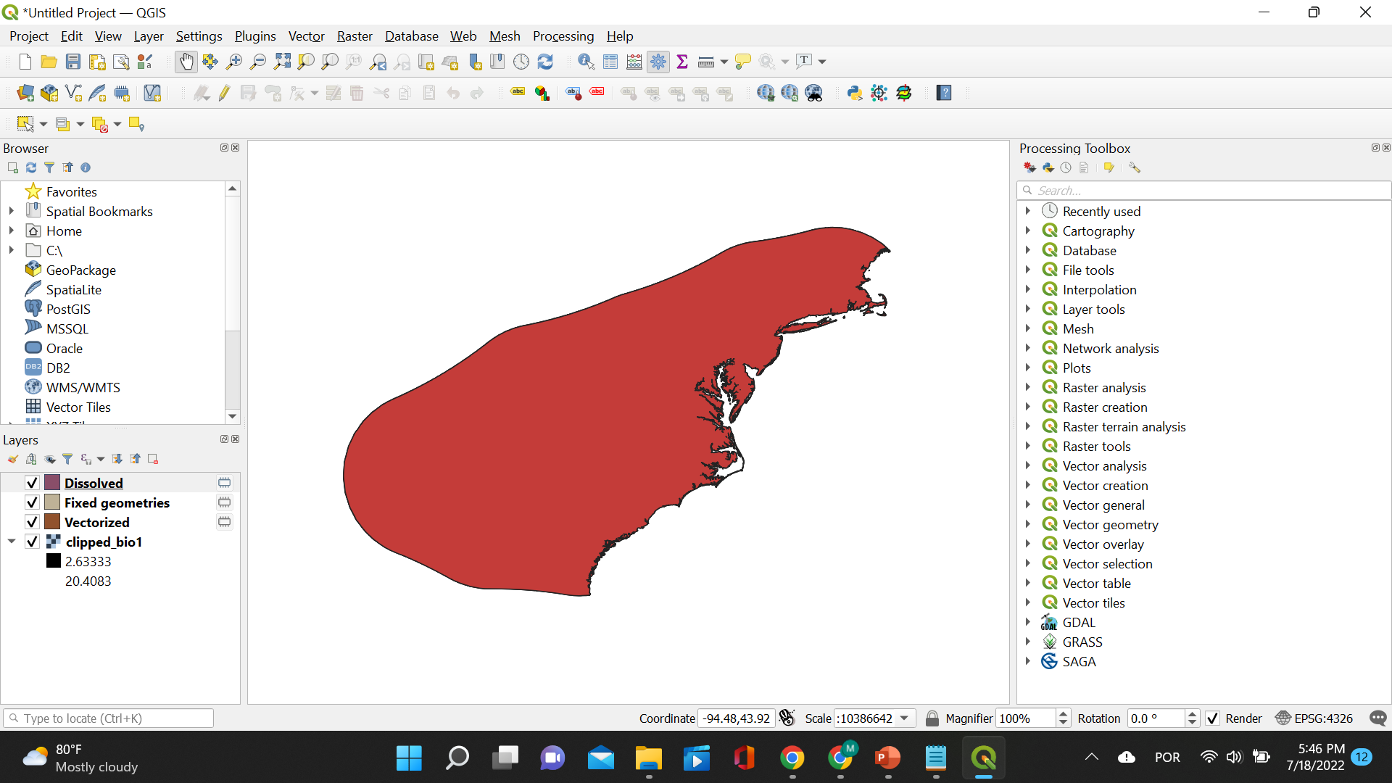
11 – Dissolve the vector
The dissolved layer will be displayed on top of the other layers. Note there are no details to this shapefile anymore, just the outline!

Slide 47
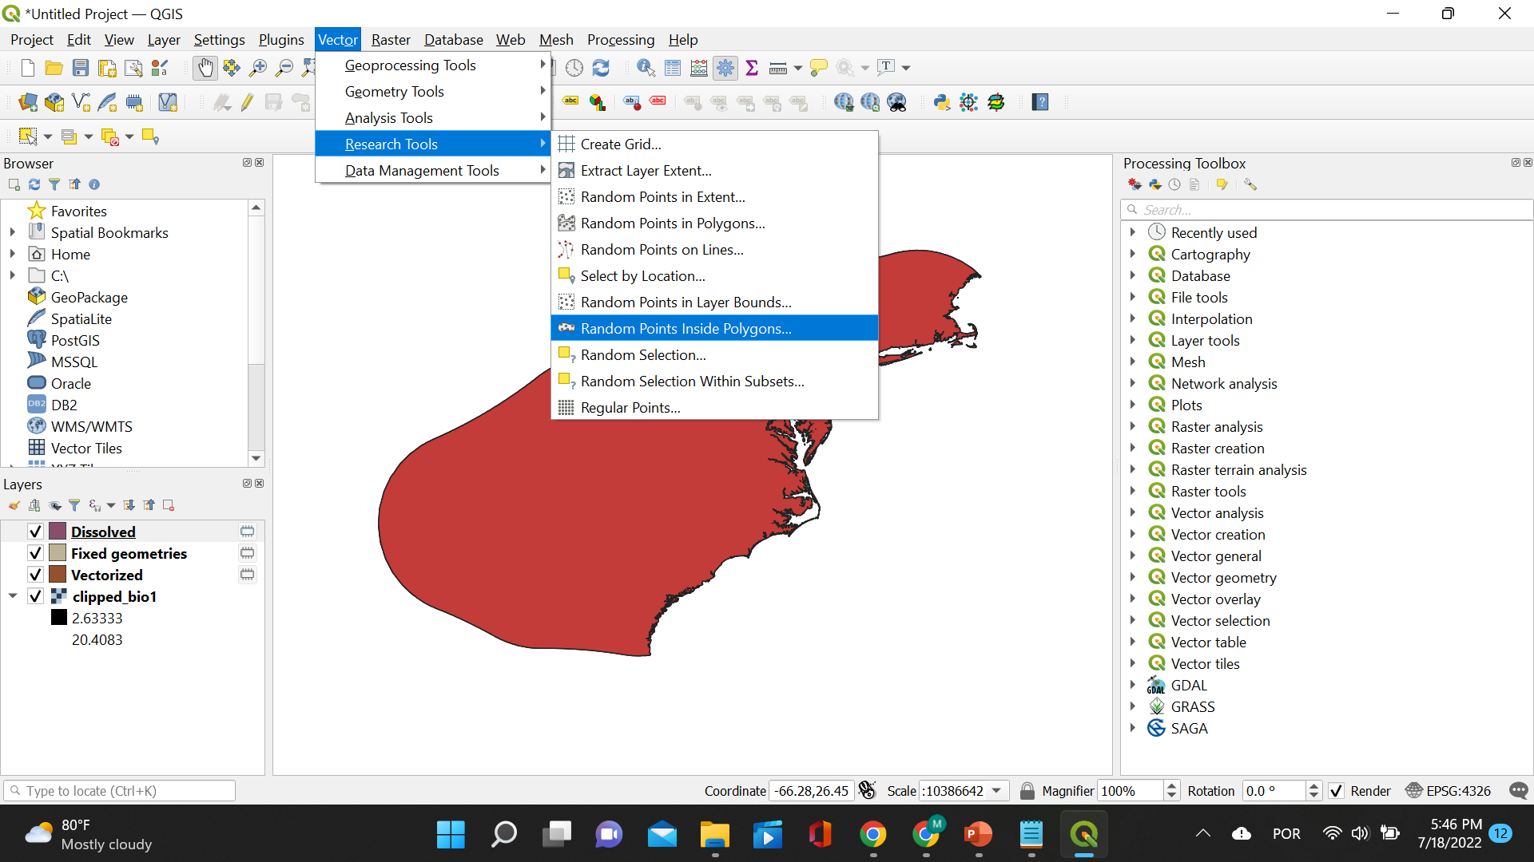
12 – Create random points
Click “Vector”, “Research Tools”, and then “Random Points Inside Polygons”

Slide 48
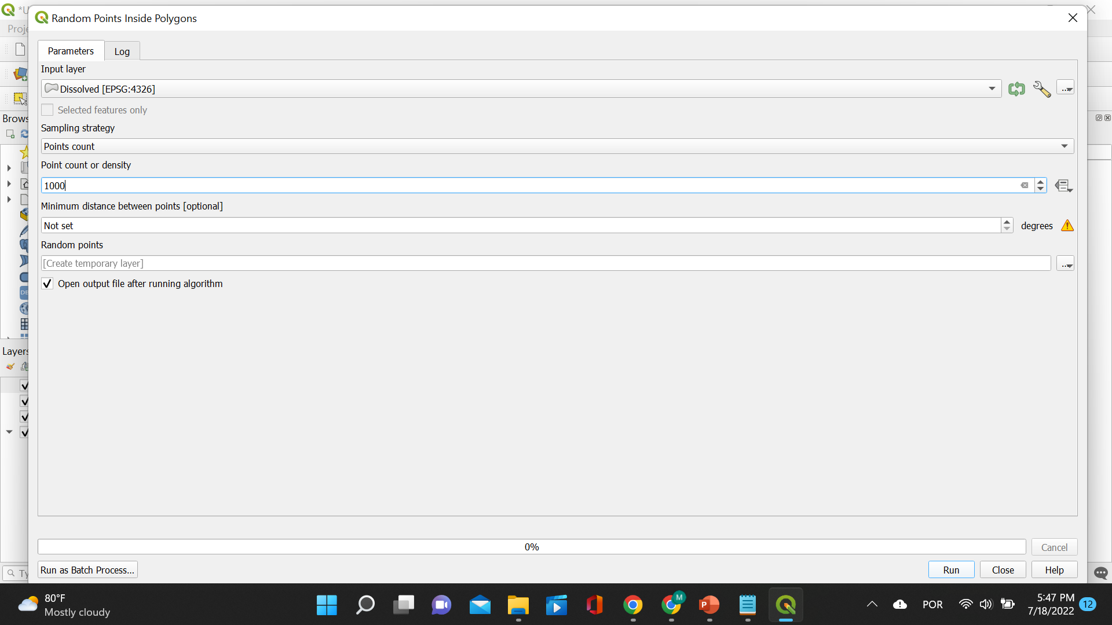
12 – Create random points
A small window will pop open. Choose the dissolved layer under “Input layer”, select Point count for “Sampling strategy”, select 1000 for “Point count or density”, and save the resulting file as .shp. Then click “Run”.

Slide 49
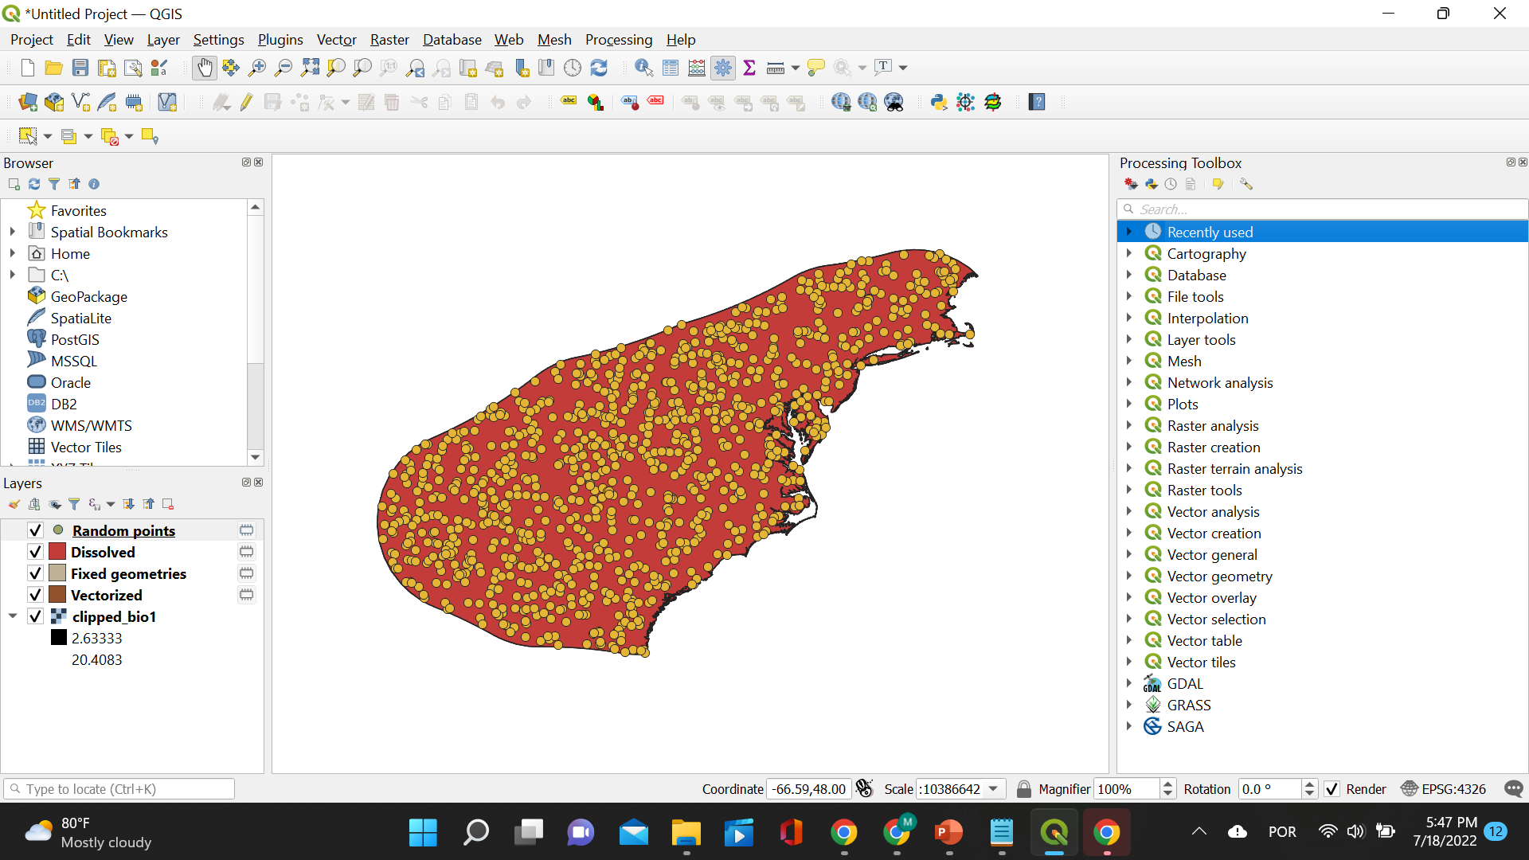
12 – Create random points
The random points layer will be displayed on top of the other layers.

Slide 50
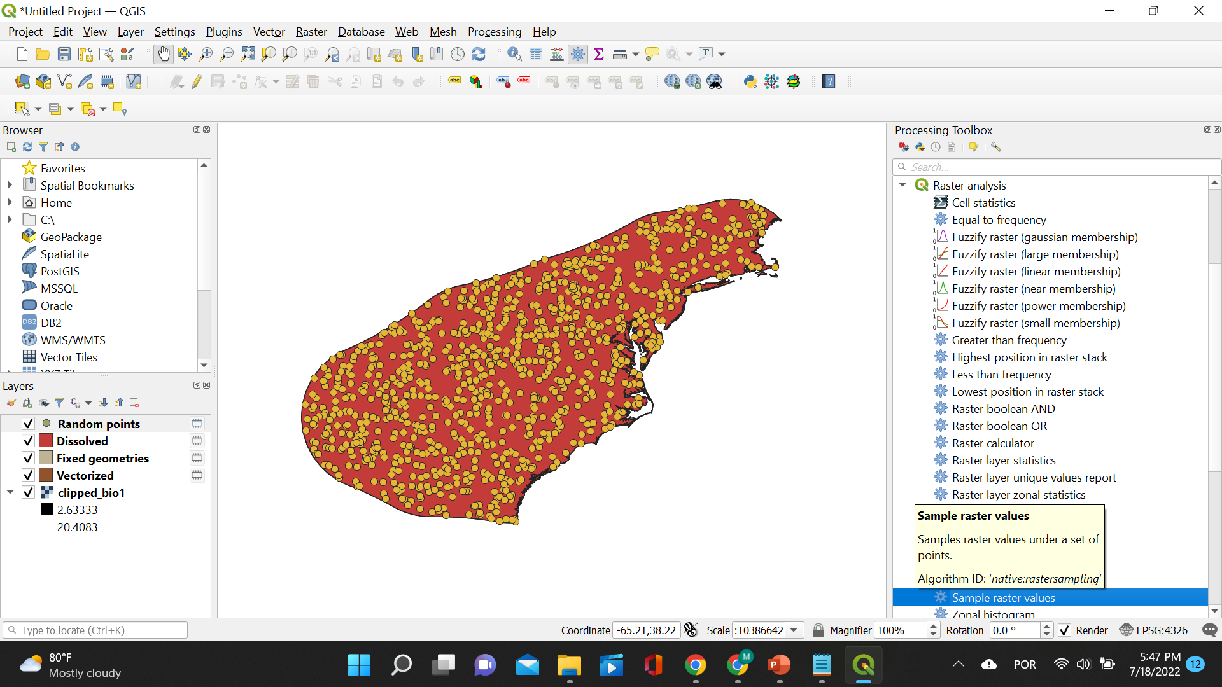
13 – Sampled clipped rasters
Under “Processing Toolbox”, click “Raster analysis” and then “Sample raster values”.

Slide 51
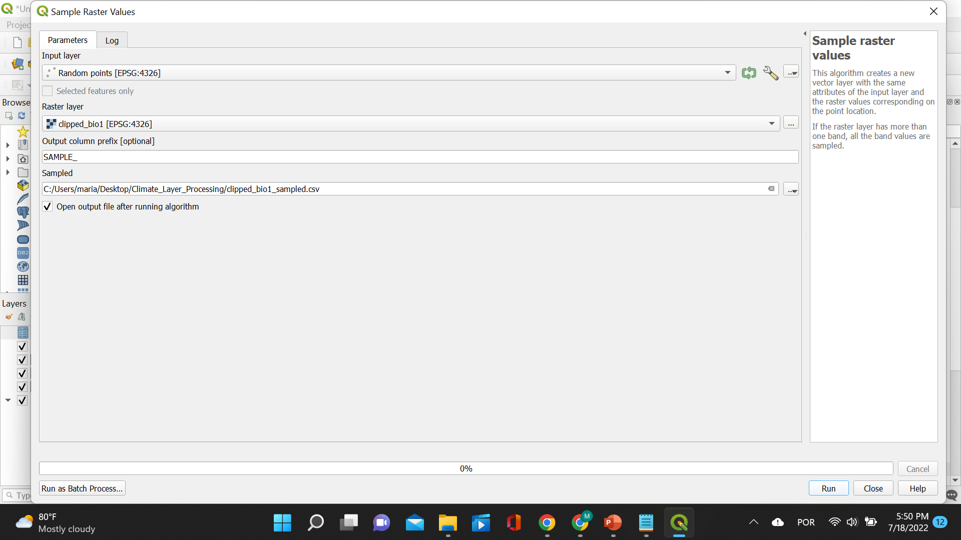
13 – Sampled clipped rasters
A small window will pop open. Choose the Random points layer under “Input layer”, select a clipped bioclim layer for “Raster layer”, and save the resulting file as .shp. Then click “Run”.

Slide 52
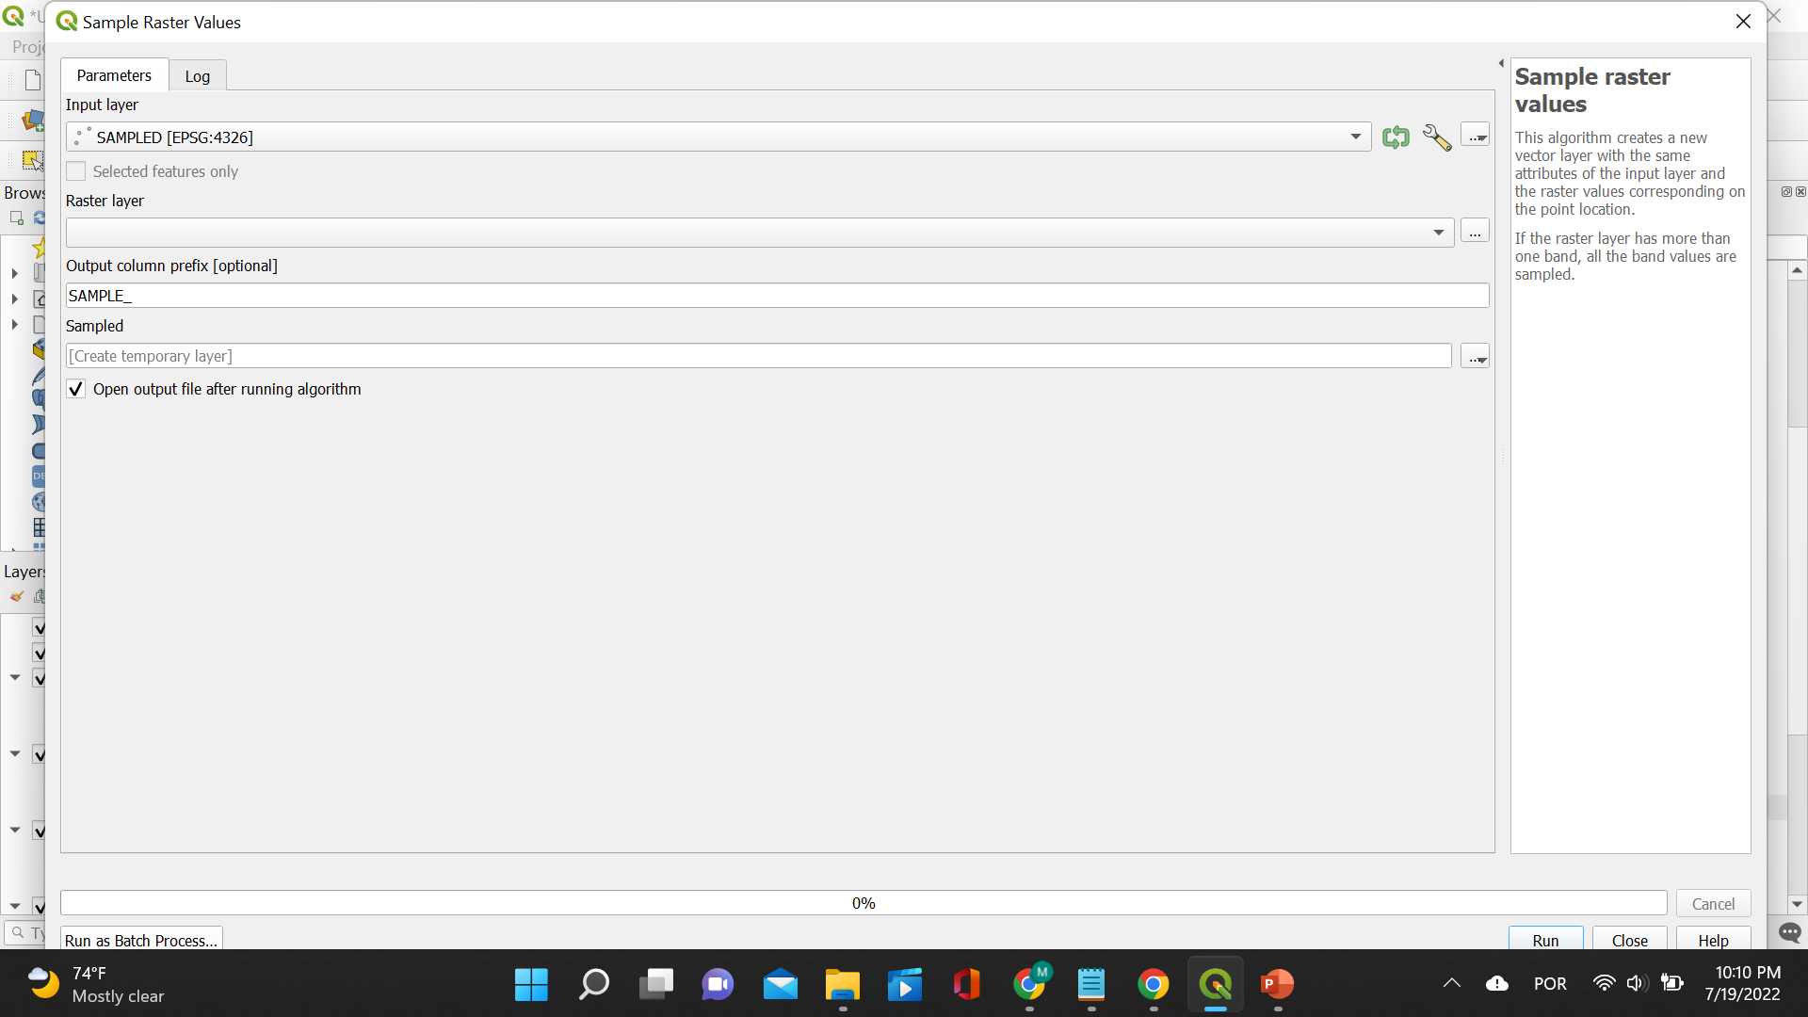
13 – Sampled clipped rasters
Alternatively, you can choose to sample all the layers at once. When the window pops open, you just click on “Run as Batch Process”!

Slide 53
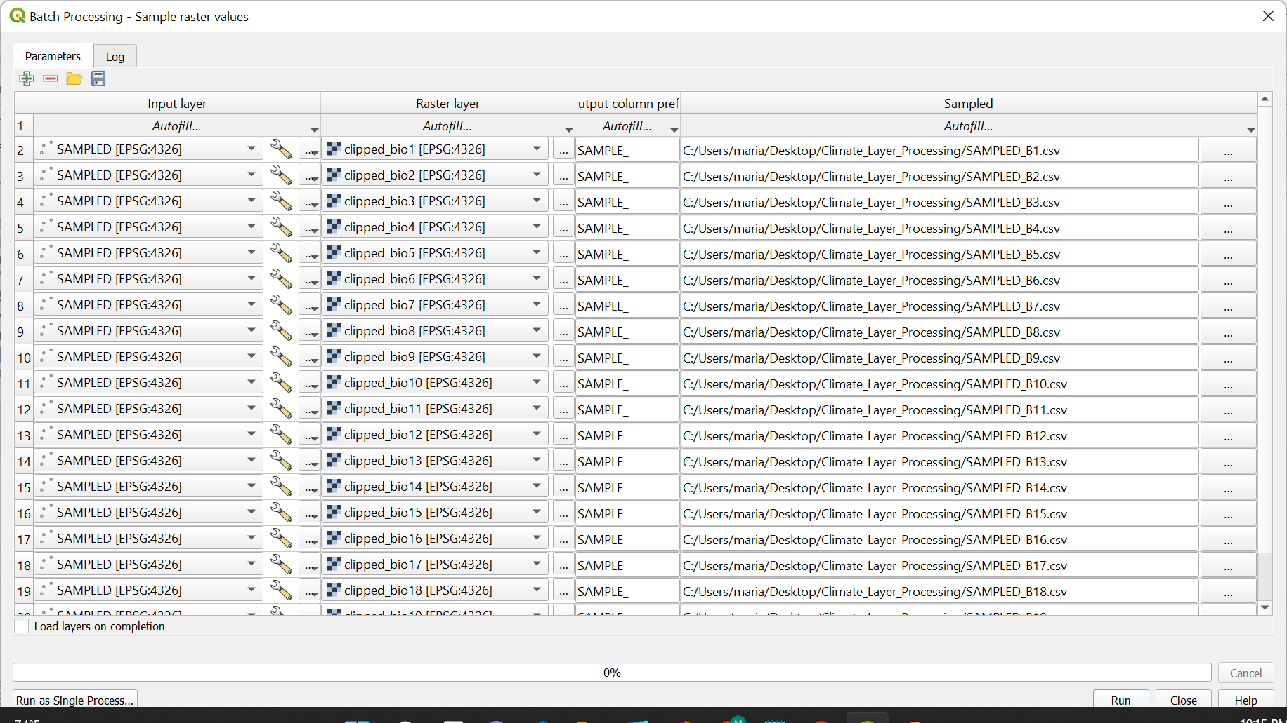
13 – Sampled clipped rasters
Now, insert the random points layer under “Input layer” and all the bioclim layers under “Raster layer”. You are using the same sampled points for all the layers! Make sure you have all the bioclim layers loaded to QGIS. You can load all of them at once by using Autofill and selecting from the folder where they are located! The last thing you need to do is save these sampled bioclim layers as .csv files so that we can calculate correlation!

Slide 54
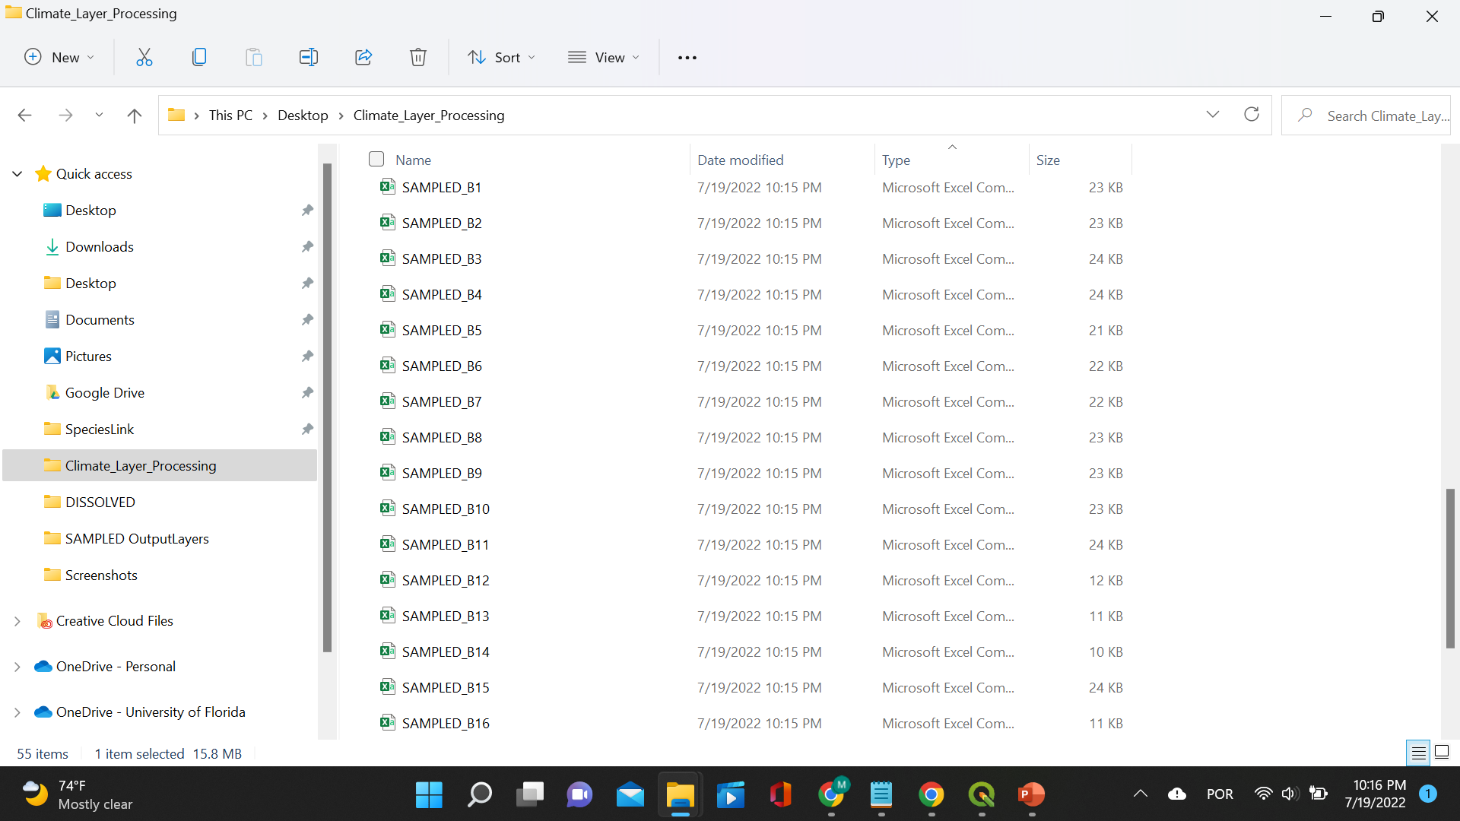
13 – Sampled clipped rasters
Here are the sampled bioclim layers!

Slide 55
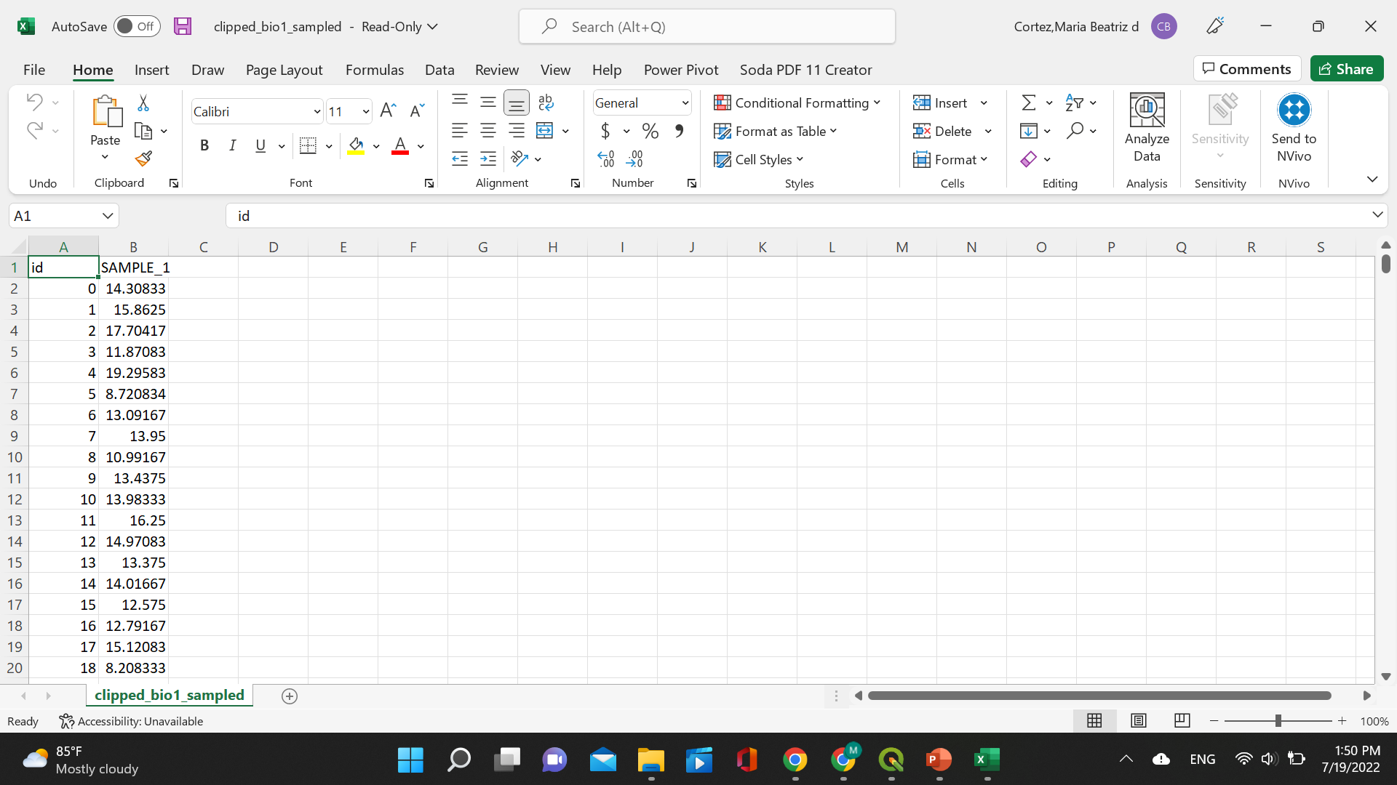
14 – Calculate correlation
Open the .csv files for each layer and copy the “SAMPLE_1” column to a different .csv file.

Slide 56
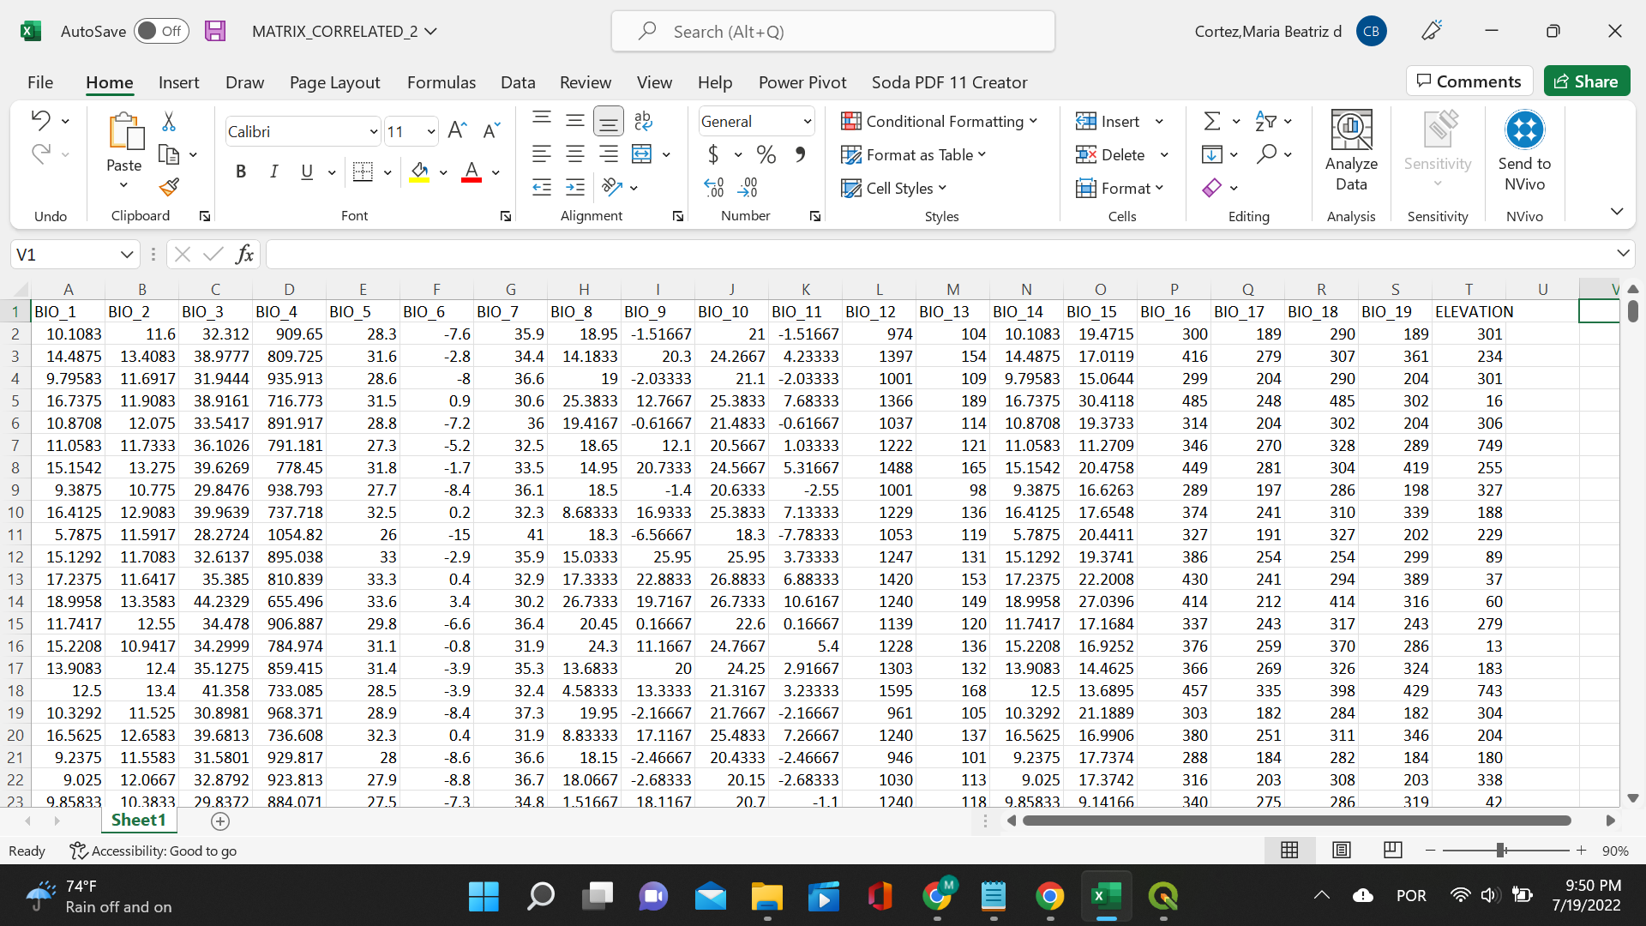
14 – Calculate correlation
Now that we have a file with all the raster values for the same points for each of the bioclim layers, it is time to calculate the correlation.

Slide 57

14 – Calculate correlation
Under “Data”, click “Data Analysis”. This is an add-in that you need to enable in your Excel! A small window will pop open; click “Correlation”.

Slide 58

14 – Calculate correlation
Select the cells you want to include in your calculation. Make sure to include all of the values for all of the layers.

Slide 59

14 – Calculate correlation
A pairwise correlation table will appear. Let’s format it to show us the layers that are very correlated! Click “Conditional Formatting”, “Highlight Cell Rules”, and “Greater Than…”. Input the number 0.7.

Slide 60

14 – Calculate correlation
The values highlighted in red are all greater than 0.7. Now, it is time to eliminate at random the highly correlated layers!

Slide 61
15 – Eliminate correlated layers

Slide 62

15 – Eliminate correlated layers
There! Only layer 14 still shows strong correlation (correlation index over 0.7)! For now, let’s keep it, so we match what is being conducted for the R track!

Slide 63
15 – Eliminate correlated layers
Now, we are ready to move on to MaxEnt to start working on the species distribution models!
We will be using the following clipped layers:
Bioclim 3
Bioclim 7
Bioclim 8
Bioclim 9
Bioclim 14
Bioclim 15
Bioclim 18
ELEVATION

